Slide 1

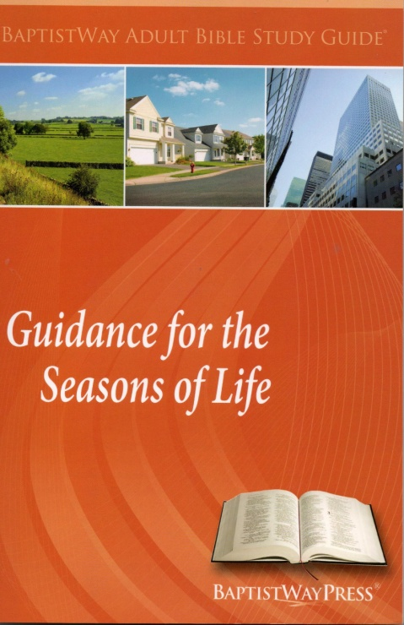
Lesson 4 of 13
June 23, 2013
“Rebekah: Finding Love” Genesis 24:34-67
Study Aim: To describe how Rebekah married Isaac and to identify implications for life today from their lives.
All Scripture quotes are from the NIV version unless otherwise indicated. Most lesson comments are from the Study Guide followed by (SG).
PowerPoint by Don Cannata
BaptistWay Press, Dallas, Texas

Slide 2

Lesson 4 – Guidance Series
“Guidance for the Seasons of Life” Series
1. Daniel and His Friends: Opting for Faithfulness
2. Samson: Realizing You’re Not Indestructible
3. Joseph: Gaining Maturity
4. Rebekah: Finding Love
5. Hannah: Praying for a Child
6. Ruth: Finding Love After Loss
7. Joseph: Using Abilities to Serve Others
8. Caleb: Offering Wise and Courageous Leadership
9. Joseph: Living in the Middle
10. David: Overwhelmed By Family Turmoil
11. Testifying of God’s Security and Deliverance
12. Let us Worship, Let Us Obey
13. Give Thanks for the Lord’s Steadfast Love

Slide 3
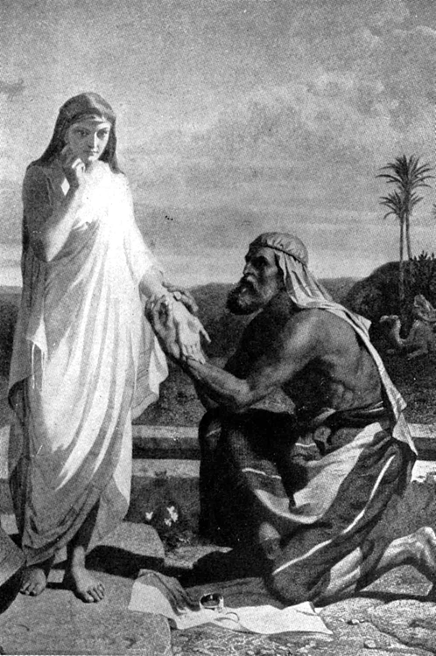
Lesson 4 - Psalms
The Story of Rebekah Is Found In the Period of The Patriarchs (approx. 1750-1350 B.C.)
Leading Personalities
Abraham
Sarah
Lot
Isaac
Rebekah
Jacob
Leah
Rachel
Joseph

Slide 4

Lesson 4 – Guidance Series
The Focus of This Lesson…
Most agree on the five defining tasks of the transition to adulthood by age thirty—
Leaving home
Finishing school
Achieving financial independence
Getting married
Becoming a parent
How does God guide us in finding someone to marry? What roles do the church and the community of faith play? SG

Slide 5
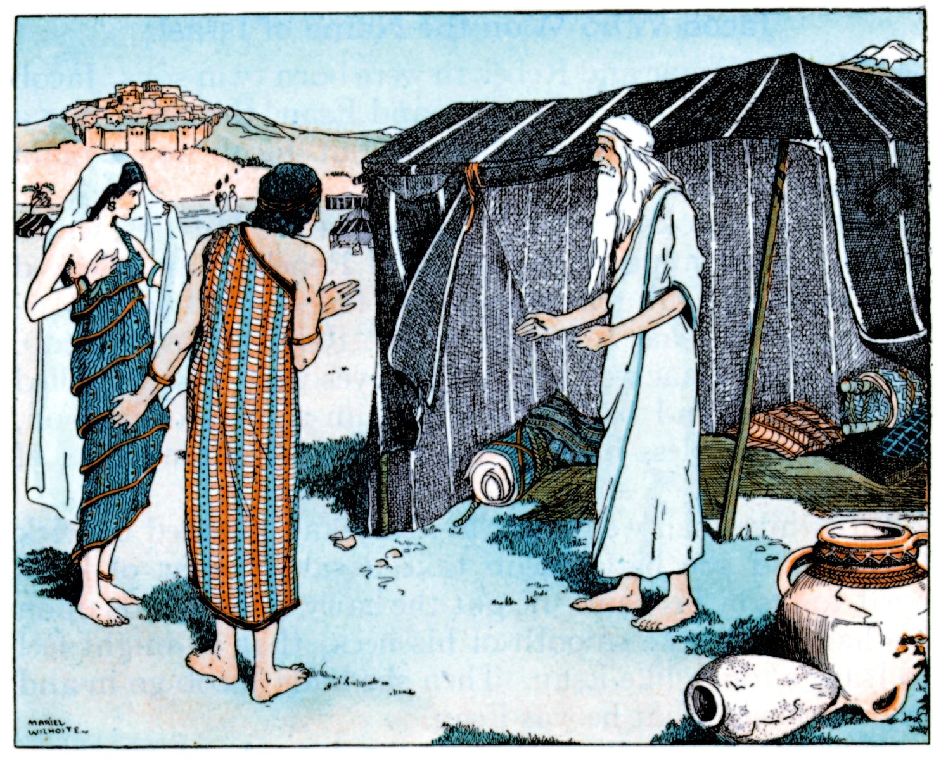
Lesson 4 – Guidance Series
Rebekah’s Story Begins
The time had come for Isaac to marry. Abraham had no desire for a Canaanite daughter-in-law.
So Abraham sent his steward to Haran, where his brother Nahor and his family still lived, in hopes of finding a wife for Isaac among his own kin.
Source: Reader’s Digest Assn., “Great People of the Bible And How they Lived” 1979, p. 43

Slide 6
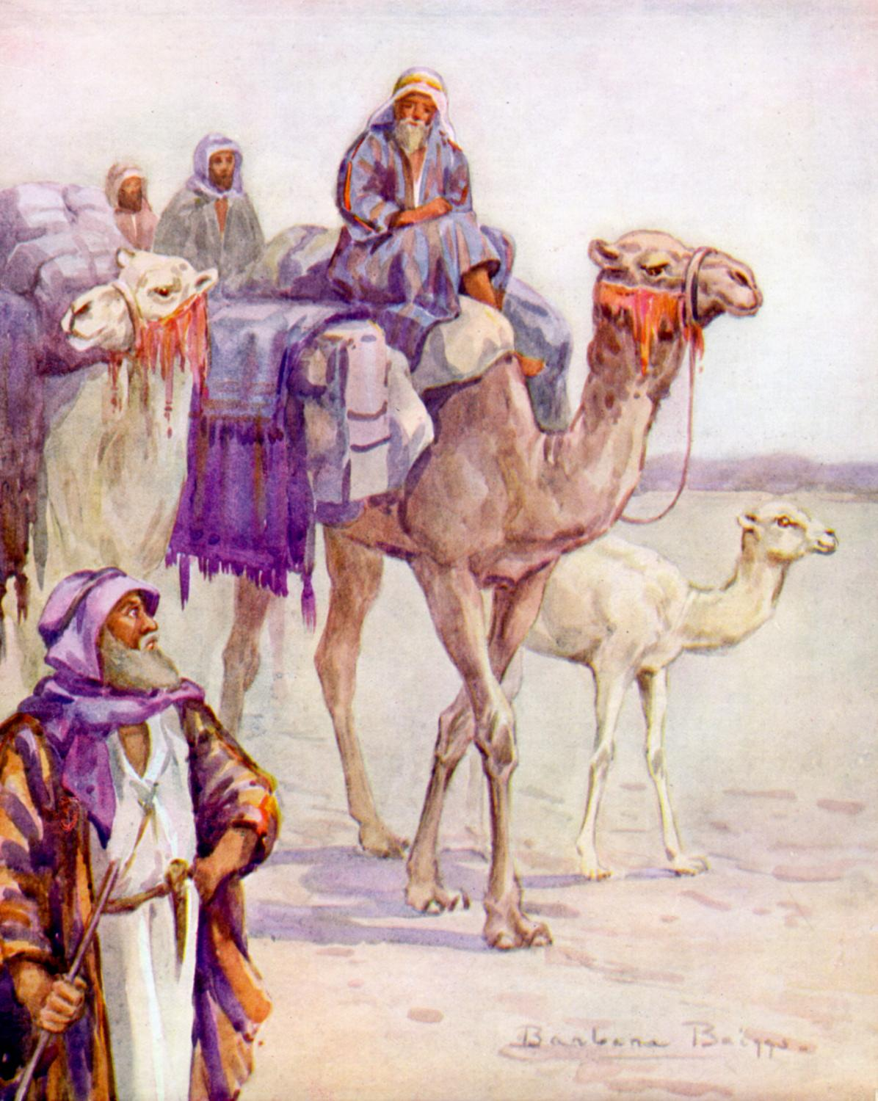
Lesson 4 – Guidance Series
The Search Begins—Gen. 24:1-41
Abraham’s servant set out with a train of ten camels – an indicator of Abraham’s great wealth – and headed for Nahor. SG
Gen. 24:37 And my master made me swear an oath, and said, ‘You must not get a wife for my son from the daughters of the Canaanites, in whose land I live,
Gen. 24:38 but go to my father’s family and to my own clan, and get a wife for my son.’

Slide 7
Lesson 4 – Guidance Series
The Search Begins—Gen. 24:1-41
When he arrived at his destination, he was faced with a problem. How would he find Abraham’s family. How would he find the right woman for Isaac to marry? SG
Gen. 24:43 See, I am standing beside this spring; if a maiden comes out to draw water and I say to her, “Please let me drink a little water from your jar,”
Gen. 24:44 and if she says to me, “Drink, and I’ll draw water for your camels too,” let her be the one the LORD has chosen for my master’s son.’

Slide 8
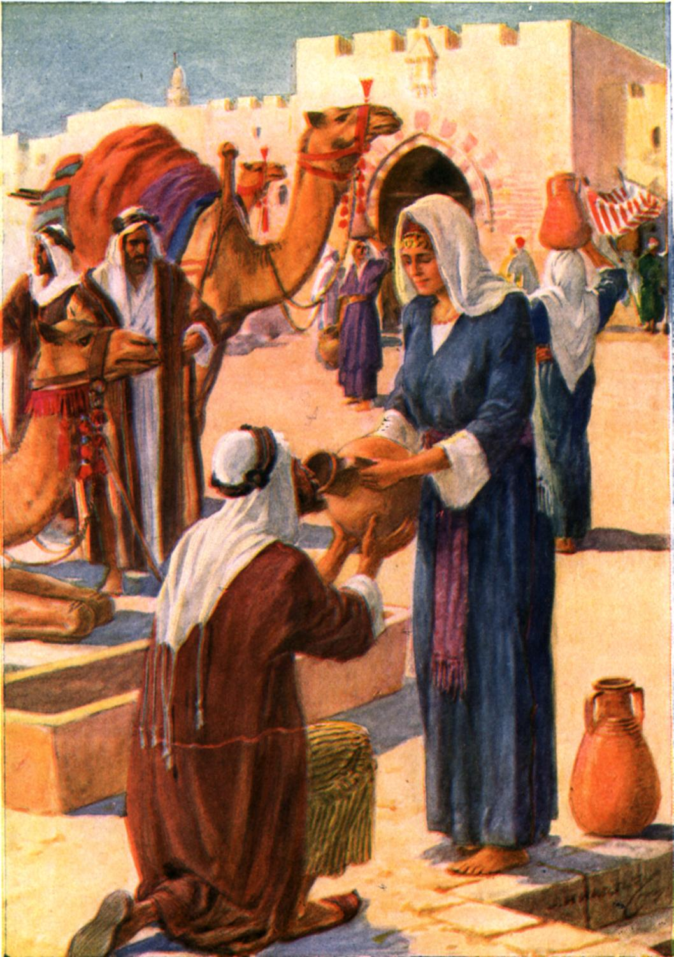
Lesson 4 – Guidance Series
The Search Begins—Gen. 24:1-41
Abraham’s servant recognized Rebekah’s extraordinary service…SG
Gen. 24:46 “She quickly lowered her jar from her shoulder and said, ‘Drink, and I’ll water your camels too.’ So I drank, and she watered the camels also.
Gen. 24:47 “I asked her, ‘Whose daughter are you?’ “She said, ‘The daughter of Bethuel son of Nahor, whom Milcah bore to him.’ “Then I put the ring in her nose and the bracelets on her arms…

Slide 9
Lesson 4 – Guidance Series
The Negotiation -- 24:34-67
Laban and Bethuel recognized that God was at work. It was this recognition of God’s hand in the relationship that convinced Rebekah’s family to let her go (50-51). SG
Gen. 24:50 Laban and Bethuel answered, “This is from the LORD; we can say nothing to you one way or the other.
Gen. 24:51 Here is Rebekah; take her and go, and let her become the wife of your master’s son, as the LORD has directed.”

Slide 10
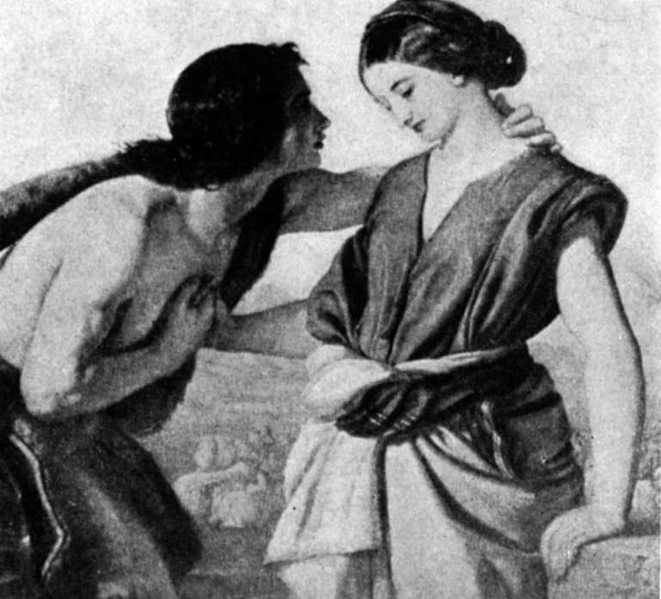
Lesson 4 – Guidance Series
The Negotiation -- 24:34-67
When Rebekah recognized Isaac as her groom, she got off her camel and veiled herself, signaling that she was his bride. SG
Gen. 24:67 Isaac brought her into the tent of his mother Sarah, and he married Rebekah. So she became his wife, and he loved her; and Isaac was comforted after his mother’s death.
“She became his wife; and he loved her” (24:67). For the moment, it was a happy ending. SG

Slide 11

Lesson 4 – Guidance Series
Isaac and Rebekah Today
We should beware of taking this story as a template for how to find a spouse today. Still, we can draw some lessons from this story. Do you agree, or disagree with these: SG
God cares about marriage.
There is a purpose in marriage greater than the happiness of two people.
Character matters.
The community of faith matters.

Slide 12

Lesson 4 – Guidance Series
Questions to Ponder About This Study
Together, the community of faith can help young adults identify how God is working in their lives to help achieve intimacy, relationship, and love. SG
How has God worked in your life to meet our needs for intimacy and love?
What are some ways God works through dating and courtship customs today?

Slide 13
Lesson 4 – Guidance Series
Questions to Ponder About This Study
3. What are some important considerations in deciding who to marry?
4. Should Christians today ask God for signs? What cautions, if any, should believers have about asking for signs?
End of Lesson 4
Lesson 5 is entitled “Hannah: Praying for A Child”

Slide 14
Lesson 4 - Psalms

Slide 15

Lesson 4 – Guidance Series
Looking for teaching ideas?
Try the Free PowerPoint Bible Teaching Help Line…
Give me an On Line question, comment or suggestion, and let’s see if I can help you. Thanks, doncannata@aol.com

