Slide 1
Lesson 3 Guidance Series
Lesson 3 of 13
June 16, 2013
“Joseph: Gaining Maturity”
Genesis 37:2-14, 18-28; 39:1-12
Study Aim: To describe how Joseph faced the challenges of his life and identify lessons for my life
All Scripture quotes are from the NIV version. Most lesson comments are from the Study Guide followed by SG
PowerPoint by Don Cannata
BaptistWay Press, Dallas, Texas

Slide 2
“Guidance for the Seasons of Life” Series
1. Daniel and His Friends: Opting for Faithfulness
2. Samson: Realizing You’re Not Indestructible
3. Joseph: Gaining Maturity
4. Rebekah: Finding Love
5. Hannah: Praying for a Child
6. Ruth: Finding Love After Loss
7. Joseph: Using Abilities to Serve Others
8. Caleb: Offering Wise and Courageous Leadership
9. Joseph: Living in the Middle
10. David: Overwhelmed By Family Turmoil
11. Testifying of God’s Security and Deliverance
12. Let us Worship, Let Us Obey
13. Give Thanks for the Lord’s Steadfast Love

Slide 3
Lesson 3 – Guidance Series
Lesson 3 in Old Testament History
“Joseph: Gaining Maturity”
(See Study Guide Chart, pp. 18-19)
1. Creation Prehistoric
2. Patriarchs 1750-1350 B.C.
3. Exodus 1350-1250 B.C.
4.Promised Land 1300-1200 B.C.
5. Judges 1200-1020 B.C.
6. Kingdom 1020-922 B.C.
7. Divided Kingdom-922-721 B.C.
8. Only Judah 721-587 B.C.
9. The Exile 597-539 B.C.
10. Return 539-333 B.C.

Slide 4
Lesson 3 – Guidance Series
Only in My Dreams 37:2-14
Joseph’s first impression in the Scriptures is unflattering -- he was a tattletale. He reported on his brothers to their father.
However, it was his status as the favored son that fueled their hatred and inability to speak a “kind” word to him. SG
Gen. 37:4 When his brothers saw that their father loved him more than any of them, they hated him and could not speak a kind word to him.

Slide 5
Lesson 3 – Guidance Series
Only in My Dreams 37:2-14
Joseph further strained his relations with his brothers when he chose to disclose to them his dreams. SG
Gen. 37:5 Joseph had a dream, and when he told it to his brothers, they hated him all the more.
Gen. 37:7 We were binding sheaves of grain out in the field when suddenly my sheaf rose and stood upright, while your sheaves gathered around mine and bowed down to it.”
How important are dreams to you?

Slide 6
Lesson 3 – Guidance Series
Only in My Dreams 37:2-14
Jacob definitely assigned Joseph the responsibility of reporting on his brothers. His future was about to change in ways he probably never anticipated. SG
Gen. 37:14 So he said to him, “Go and see if all is well with your brothers and with the flocks, and bring word back to me.” Then he sent him off from the Valley of Hebron.

Slide 7
Lesson 3 – Guidance Series
Keep the Dream(er) Alive 37:18-28
What do you do when your arch nemesis, the one you hate with deep abiding passion, appears unannounced to examine you so he can report back to your authorities? Throw him in a cistern, of course! SG
Gen. 37:20 “Come now, let’s kill him and throw him into one of these cisterns and say that a ferocious animal devoured him. Then we’ll see what comes of his dreams.”

Slide 8
Lesson 3 – Guidance Series
Keep the Dream(er) Alive 37:18-28
They substituted greed for murder. Judah suggested they sell Joseph to the traders and the caravan for twenty shekels of silver. SG
Gen. 37:28 So when the Midianite merchants came by, his brothers pulled Joseph up out of the cistern and sold him for twenty shekels of silver to the Ishmaelites, who took him to Egypt.

Slide 9
Lesson 3 – Guidance Series
Beautiful Dreamer 39:1-12
Bought by Potiphar, of Pharaoh’s officials and captain of the guard, Joseph began as a house-servant, not a field hand.
Joseph received a promotion to Potiphar’s attendant, a term used exclusively for a personal assistant, not one performing menial tasks. SG
Gen. 39:6 So he left in Joseph’s care everything he had; with Joseph in charge, he did not concern himself with anything except the food he ate. Now Joseph was well-built and handsome…

Slide 10
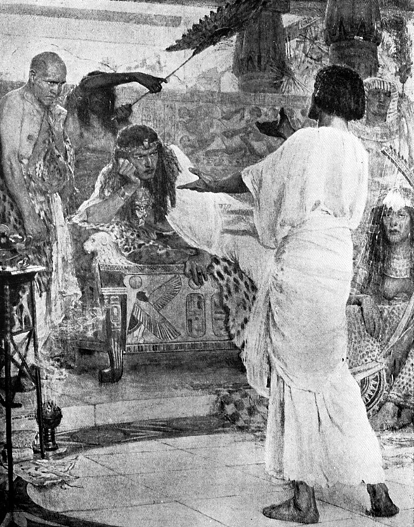
Lesson 3 – Guidance Series
Beautiful Dreamer 39:1-12
Potiphar’s wife apparently agreed with this description of Joseph. It took some time, but eventually she expressed her interest in him without ambiguity! SG
Gen. 39:7 …and after a while his master’s wife took notice of Joseph and said, “Come to bed with me!”
Gen. 39:8 But he refused. “With me in charge,” he told her, “my master does not concern himself with anything in the house; everything he owns he has entrusted to my care.

Slide 11
Lesson 3 – Guidance Series
Beautiful Dreamer 39:1-12
Joseph refused her sexual advance for three reasons. He would not –
Abuse the trust of his employer
Offend her husband by violating their marriage covenant
Sin against God SG
Gen. 39:9 No one is greater in this house than I am. My master has withheld nothing from me except you, because you are his wife. How then could I do such a wicked thing and sin against God?”

Slide 12
Lesson 3 – Guidance Series
Maturity’s Journey
Immaturity breeds pride, insecurity, contempt for authority, self-centeredness, greed, inflexibility, and rash choices in response to circumstances.
From his dreams to the dry cistern to Potiphar’s house to prison, God was preparing Joseph to rule Egypt in a time of great difficulty.
The story of Joseph reveals that in spite of suffering divine purposes are at work and will be accomplished by a sovereign and redeeming God. SG

Slide 13
Lesson 3 – Guidance Series
Implications and Actions
While God’s methods may seem haphazard or confounding, God prioritizes individual development and growth… SG
How do you define maturity?
Think about yourself at age seventeen. Were you confident of your maturity and ability to make good decisions?
3. Do you think Joseph had a kind of wanderlust, that his dreams further fueled the fire to see and experience the world?

Slide 14
Lesson 3 – Guidance Series
4. Why do you think God allowed Joseph to be enslaved and go to prison for an infidelity he did not commit? What, if any, benefit was there?
5. How do these Scripture passages speak to our season of life?
Implications and Actions
End of Lesson 3
Lesson 4 is entitled “Rebekah: Finding Love” with the focal text: Genesis 24:34-67

Slide 15
Lesson 3 – Guidance Series

Slide 16
Lesson 3 – Guidance Series
Looking for teaching ideas?
Try the Free PowerPoint Bible Teaching Help Line…
Give me an On Line question, comment or suggestion, and let’s see if I can help you. Thanks, doncannata@aol.com

