Slide 1
Lesson 10 of 13
May 5, 2013
“A Desperate Cry”
Psalm 69
New Testament Quotations:
John 2:17;15:25; Acts 1:20;
Rom.11:9-10;15:3
Study Aim: To summarize the psalmist’s prayer of desperation and identify ways it touches my life
All Scripture quotes are from the NIV version unless otherwise indicated. Most lesson comments are from the Study Guide followed by SG.
PowerPoint by Don Cannata
BaptistWay Press, Dallas, Texas

Slide 2
Overview of 13 Lesson Series in Psalms
1. Lord of All
2. God’s Majestic Greatness
3. It’s a Wonderful Life
4. Trusting God in the Darkest Hour
5. Committed to the Lord
6. The Joy of Forgiveness
7. Desiring Life and Finding Its Source
8. Gratitude for God’s Help
9. No One Does Good
10. A Desperate Cry
11. Testifying of God’s Security and Deliverance
12. Let us Worship, Let Us Obey
13. Give Thanks for the Lord’s Steadfast Love

Slide 3
Lesson 10 – Psalms
A Desperate Cry – Psalm 69
Psalm 69 begins with sinking (vv. 1-3) but ends with singing (vv. 30-36). It goes from prayer to praise, from reproach to rejoicing, because David poured out his heart to the Lord.
No matter how painful your situation may be, tell God exactly how you feel.
Source: Warren W. Wiersbe, With The Word, Thomas Nelson, Nashville, 1991,
p. 352

Slide 4
Lesson 10 – Psalms
Statement of Complaint (69:1-12)
The psalmist painted a vivid picture of the circumstances that threatened to overwhelm him. He pictured the many troubles as raging flood waters that had swept into his life. SG
Psa. 69:1 Save me, O God, for the waters have come up to my neck.
Psa. 69:2 I sink in the miry depths, where there is no foothold. I have come into the deep waters; the floods engulf me.

Slide 5
Lesson 10 – Psalms
Statement of Complaint (69:1-12)
Verse 4 refers to a multitude of people who had brought charges against the psalmist. If the psalm was indeed composed by David, it may be that these opponents were accusing him of stealing the throne from Saul’s family. SG
Psa. 69:4 Those who hate me without reason outnumber the hairs of my head; many are my enemies without cause, those who seek to destroy me. I am forced to restore what I did not steal.

Slide 6
Lesson 10 – Psalms
Statement of Complaint (69:1-12)
Whatever David’s past weaknesses might have been, verses 7-12 make it clear that he saw his current oppression as a result of seeking to follow God. SG
Psa. 69:7 For I endure scorn for your sake, and shame covers my face.
Psa. 69:8 I am a stranger to my brothers, an alien to my own mother’s sons;
Psa. 69:9 for zeal for your house consumes me, and the insults of those who insult you fall on me.

Slide 7
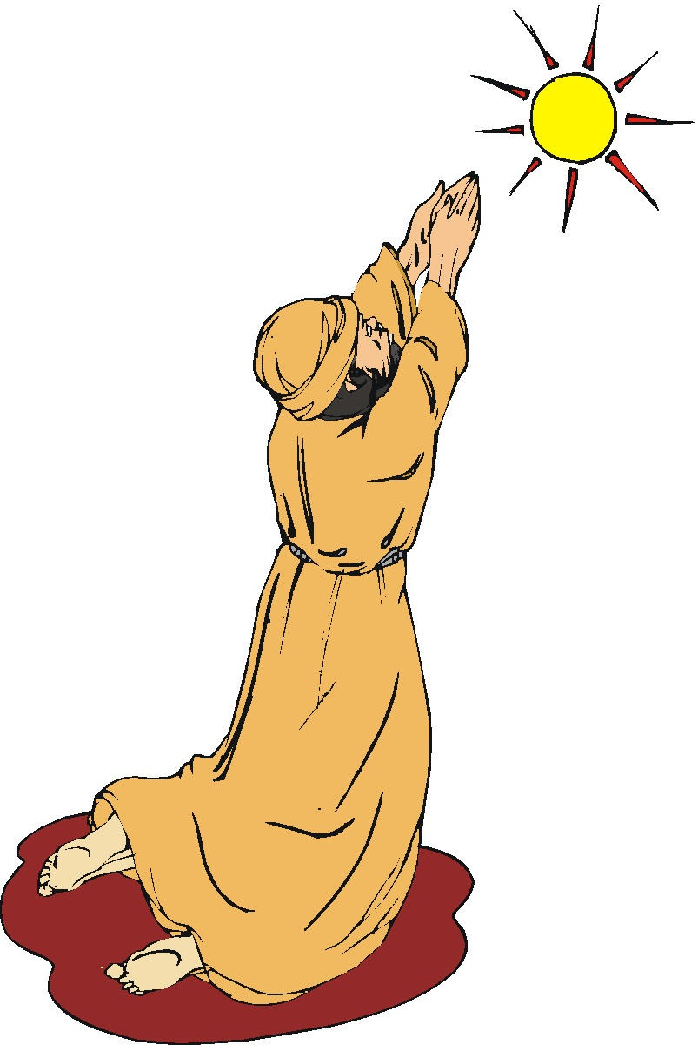
Lesson 10 – Psalms
Plea for God’s Help (69:13-21)
Verses 13 and 16 reveal that the psalmist’s expectation of God’s answer was based on the psalmist’s under-standing of the mercy and loving- kindness of God. Such depth of under- standing had grown out of experience.SG
Psa. 69:13 But I pray to you, O LORD, in the time of your favor; in your great love, O God, answer me with your sure salvation.
Psa. 69:16 Answer me, O LORD, out of the goodness of your love; in your great mercy turn to me

Slide 8
Lesson 10 – Psalms
Plea for God’s Help (69:13-21)
Verses 17-18 appear to be the heart of the entire psalm as the psalmist declared his total dependence on God by calling for God to redeem him. He knew that it was only through God’s actions that the psalmist had any hope. SG
Psa. 69:17 Do not hide your face from your servant; answer me quickly, for I am in trouble.
Psa. 69:18 Come near and rescue me; redeem me because of my foes.

Slide 9
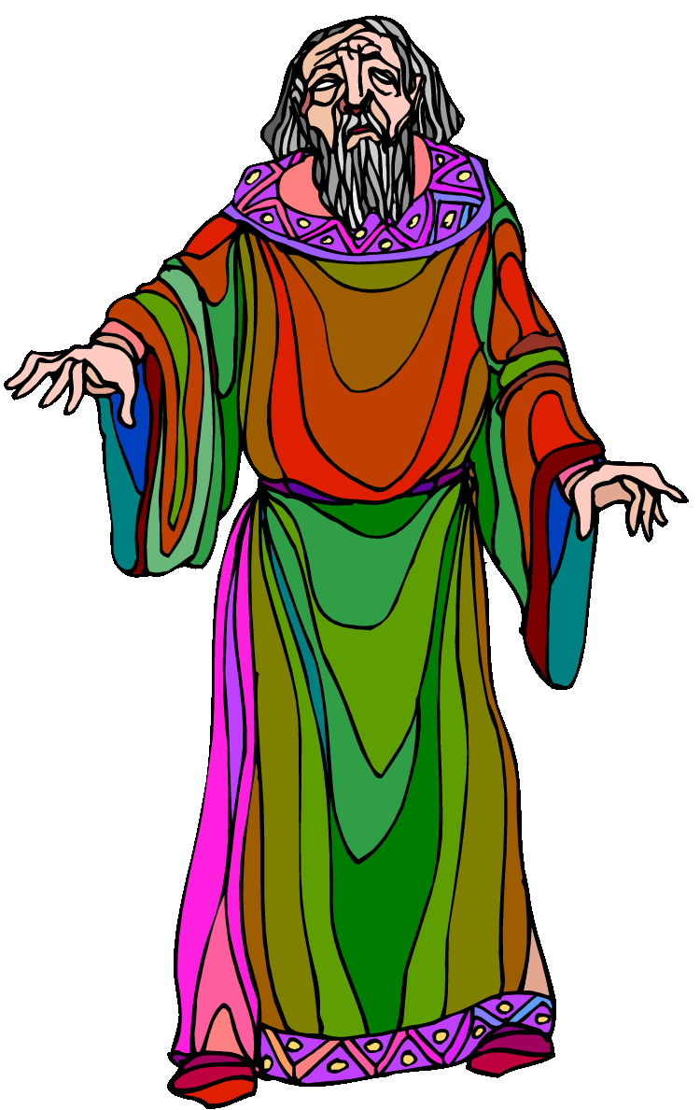
Lesson 10 – Psalms
Cry for God’s Judgment (69:22-29)
In the call for revenge against his oppressors, these verses show the psalmist’s complete honesty before God. This psalm assures us that it is acceptable to voice these desires to God. SG
Psa. 69:23 May their eyes be darkened so they cannot see, and their backs be bent forever.
Psa. 69:24 Pour out your wrath on them; let your fierce anger overtake them.
Psa. 69:25 May their place be deserted; let there be no one to dwell in their tents.

Slide 10
Lesson 10 – Psalms
Confident Exclamation of Praise (69:30-36)
Now the psalmist stated that when others saw how God moved in his life in rescuing him from the flood waters, they would be strengthened in their faith. SG
Psa. 69:30 I will praise God’s name in song and glorify him with thanksgiving.
Psa. 69:33 The LORD hears the needy and does not despise his captive people.
Psa. 69:34 Let heaven and earth praise him, the seas and all that move in them,
Psa. 69:35 for God will save Zion and rebuild the cities of Judah. Then people will settle there and possess it;

Slide 11
Lesson 10 – Psalms
Implications and Actions
Psalm 69 teaches us that God welcomes even our complaints as we cry out to him. Furthermore, God promises to handle our complaints in his own timing. SG
1. Has there been a time when you wrestled with your prayers and God’s timing in answering? What happened?
2. How do you feel about the idea of complaining or questioning God in prayer?

Slide 12
Lesson 10 – Psalms
Implications and Actions
3. When was the last time that honest prayer moved you from desperation to declaration? How did it change the situation?
4. In relation to the difficulties of life, what message does your life send to others?
End of Lesson 10
Lesson 11 is entitled “Testifying of God’s Security and Deliverance” – Text: Psalm 91

Slide 13
Lesson 10 – Psalms

