Slide 1

Lesson 7 of 13
April 14, 2013
“Desiring Life and Finding Its Source”
Focal Text: Psalm 34
Quotations from Psalm 34 in the New Testament: 1 Peter 3:10-12
Study Aim: To identify the source of true life and to affirm or reaffirm that source for my own life.
All Scripture quotes are from the NIV version unless otherwise indicated. Most lesson comments are from the Study Guide followed by (SG).
PowerPoint by Don Cannata
BaptistWay Press, Dallas, Texas

Slide 2

Lesson 7 - Psalms
Overview of 13 Lesson Series in Psalms
1. Lord of All
2. God’s Majestic Greatness
3. It’s a Wonderful Life
4. Trusting God in the Darkest Hour
5. Committed to the Lord
6. The Joy of Forgiveness
7. Desiring Life and Finding Its Source
8. Gratitude for God’s Help
9. No One Does Good
10. A Desperate Cry
11. Testifying of God’s Security and Deliverance
12. Let us Worship, Let Us Obey
13. Give Thanks for the Lord’s Steadfast Love

Slide 3
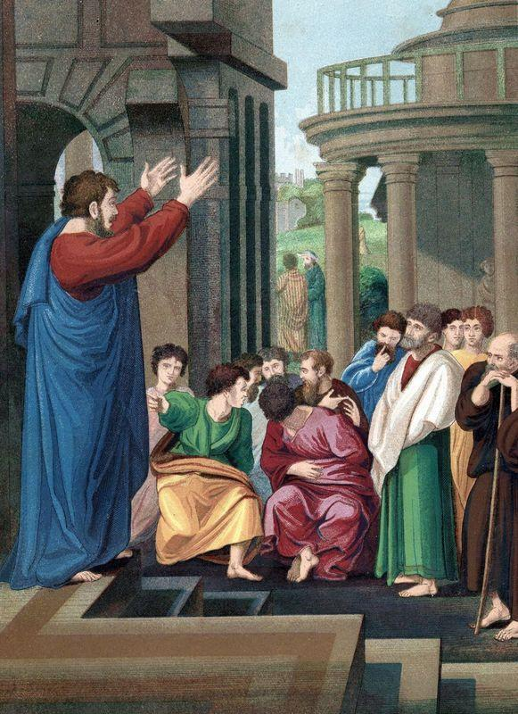
Lesson 7 - Psalms
Gaining Insights into the Psalms
These thirteen lessons included in this study of “Psalms: Songs from the Heart of Faith” will span most of the basic psalm types that appear in the Book of Psalms.
These lessons were designed to highlight those psalms that the New Testament church found useful in its own faith journey and worship of Jesus Christ as Lord.
Source: Teaching Guide, p. 12

Slide 4
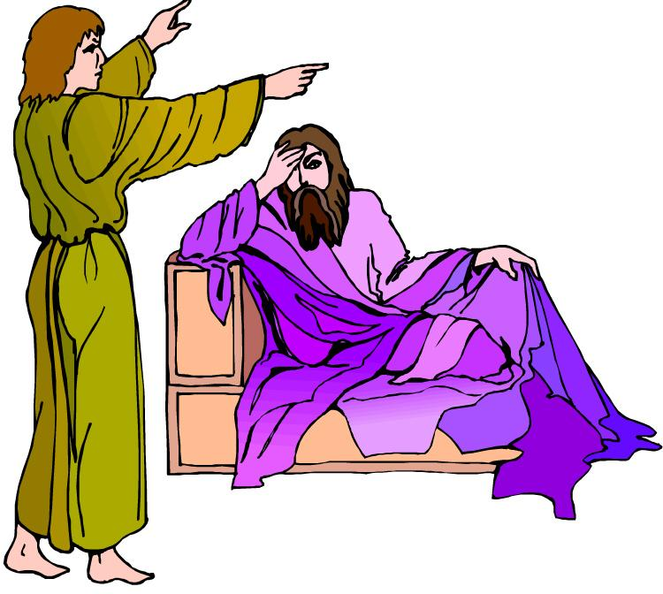
Lesson 7 - Psalms
The Focus of the Lesson (Psalm 34)
This psalm belongs to the Davidic collection. It is one of thirteen in this book whose superscription or heading states a connection with a specific event in the life of David.
The heading seemingly refers to the events recorded in 1 Samuel 21:10-15, when David acted in a bizarre way in order to be sent away by the Philistine king. SG

Slide 5

Lesson 7 - Psalms
Glorify the Lord (34:1-3)
The psalmist was serious in his bragging about what the Lord had done for him in his life.
The word “afflicted” (34:2) can also be rendered as poor or humble. It usually carries the sense of having been delivered from crisis or trouble. The psalmist encouraged others to join him in bragging on God. SG

Slide 6
Lesson 7 - Psalms
Glorify the Lord (34:1-3)
Psa. 34:1 I will extol the LORD at all times; his praise will always be on my lips.
Psa. 34:2 My soul will boast in the LORD; let the afflicted hear and rejoice.
Psa. 34:3 Glorify the LORD with me; let us exalt his name together.

Slide 7
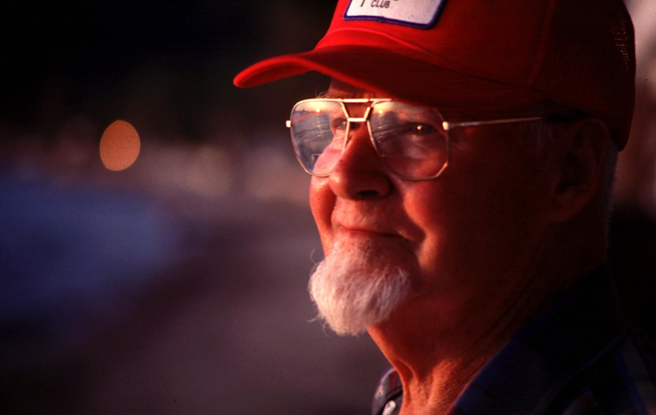
Lesson 7 - Psalms
Seek the Lord (34:4-7)
In these verses the psalmist revealed that God had delivered him from a troubling situation (34:4,6).
When we genuinely seek God, we can trust God to deliver us from trouble and to protect us. “The angel of the Lord” (34:7) is the one through whom we experience this protection.SG

Slide 8
Lesson 7 - Psalms
Seek the Lord (34:4-7)
Psa. 34:4 I sought the LORD, and he answered me; he delivered me from all my fears.
Psa. 34:5 Those who look to him are radiant; their faces are never covered with shame.
Psa. 34:6 This poor man called, and the LORD heard him; he saved him out of all his troubles.
Psa. 34:7 The angel of the LORD encamps around those who fear him, and he delivers them.

Slide 9

Lesson 7 - Psalms
Fear the Lord (34:8-14)
It is hard to overestimate the importance of what it meant to “fear the Lord” (34:7,9,11). To fear God was to have an extreme reverence or respect for God, to trust God completely, and to express total dependence on God. SG
Psa. 34:9 Fear the LORD, you his saints, for those who fear him lack nothing.

Slide 10

Lesson 7 - Psalms
Honor the Lord (34:15-22)
It is true that Yahweh’s attention and care is lavished on the “righteous,” or those who are living up to God’s right standards, while he is in opposition to the acts of wicked people (34:15-16).
It is also true that the end result of wickedness is God’s condemnation and destruction (34:21).
It is not true, however, that right-living people have a divine guarantee that they will experience no trouble whatsoever. SG

Slide 11
Lesson 7 - Psalms
Honor the Lord (34:15-22)
Psa. 34:15 The eyes of the LORD are on the righteous and his ears are attentive to their cry;
Psa. 34:16 the face of the LORD is against those who do evil, to cut off the memory of them from the earth.
Psa. 34:17 The righteous cry out, and the LORD hears them; he delivers them from all their troubles.
Psa. 34:19 A righteous man may have many troubles, but the LORD delivers him from them all;

Slide 12

Lesson 7 - Psalms
Implications And Actions
When we discover that God is the source of true life, we experience God’s blessings.
As a result we should desire to share that blessedness with others by bragging on God to everyone who will listen. SG
1. What are five things about the life and work of Jesus you could brag to others about him?
2. What evidence do we have that God actually wants to be found by those who sincerely seek him?

Slide 13
Lesson 7 - Psalms
Implications And Actions
3. How do you think that church leaders today could help people express more reverence and respect for God in their lives?
End of Lesson 7
Lesson 8 is entitled “Gratitude for Gods Help” with the focal text Psalm 40

Slide 14
Lesson 7 - Psalms

