Slide 1
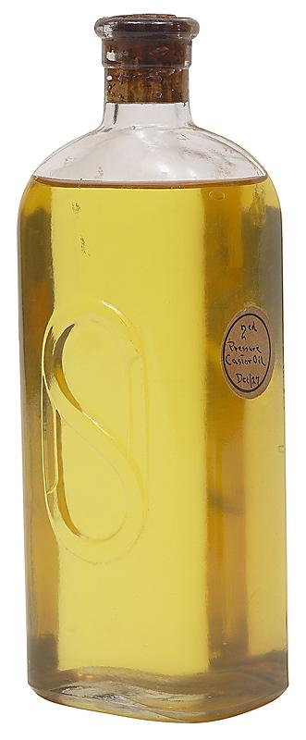

Lesson 4 of 13
March 24, 2013
“Trusting God in the Darkest Hour” -- Psalm 22
Quotations from Psalm 22 in the New Testament are found in Matt. 27:43,
46;Mark 15:34; John 19:24;
Hebrews 2:12
Study Aim: To identify resources for facing my darkest hour
All Scripture quotes are from the NIV version unless otherwise indicated. Most lesson comments are from the Study Guide followed by (SG).
PowerPoint by Don Cannata
BaptistWay Press, Dallas, Texas

Slide 2

Lesson 4 - Psalms
Understanding More About the Psalms
Let us read and enjoy these grand expressions of praise.
They are of God for you. Sing them and make them your own. Catch David’s note and spirit. He wrote marching songs, prayer songs, rally songs, hilltop songs, confession songs. Sing as you march. Keep step with David and David’s Lord all the way.
Source: “What the Bible Is All About”, NIV Version, Gospel Light Publications, 1998,
p. 199

Slide 3

Lesson 4 - Psalms
Overview of 13 Lesson Series in Psalms
1. Lord of All
2. God’s Majestic Greatness
3. It’s a Wonderful Life
4. Trusting God in the Darkest Hour
5. Committed to the Lord
6. The Joy of Forgiveness
7. Desiring Life and Finding Its Source
8. Gratitude for God’s Help
9. No One Does Good
10. A Desperate Cry
11. Testifying of God’s Security and Deliverance
12. Let us Worship, Let Us Obey
13. Give Thanks for the Lord’s Steadfast Love

Slide 4
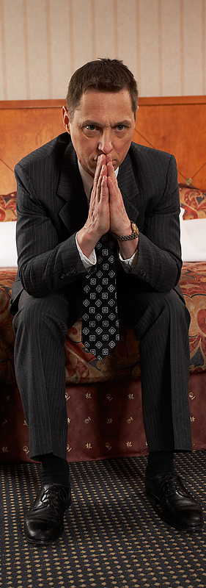
Lesson 4 - Psalms
The Focus of This Lesson…
Psalm 22 conveys an intensity of emotion hardly found elsewhere in the Book of Psalms. The language is comprehensive in describing the despair of suffering and the declaration of thanksgiving.
The author of Psalm 22 had faced a desperate situation that he thought would take his life. In this dark night of his soul he prayed for God’s help and he trusted God (Psalm 22:1-21). SG

Slide 5

Lesson 4 - Psalms
Trusting God in Our Past (22:1-11)
Psa. 22:1 My God, my God, why have you forsaken me? Why are you so far from saving me, so far from the words of my groaning?
Psa. 22:2 O my God, I cry out by day, but you do not answer, by night, and am not silent.
The psalmist consistently prayed that God would help him but received no answer (22:2) Yet he still believed in God (22:3-5). SG
When have you ever felt this way?

Slide 6
Lesson 4 - Psalms
Trusting God in Our Past (22:1-11)
He felt trampled or crushed by these critics and felt himself to be less than human, or wormlike (22:6). SG
Psa. 22:6 But I am a worm and not a man, scorned by men and despised by the people.
Psa. 22:7 All who see me mock me; they hurl insults, shaking their heads:
Psa. 22:8 “He trusts in the LORD; let the LORD rescue him. Let him deliver him, since he delights in him.”
Have you ever had someone ridicule you because of your faith?

Slide 7
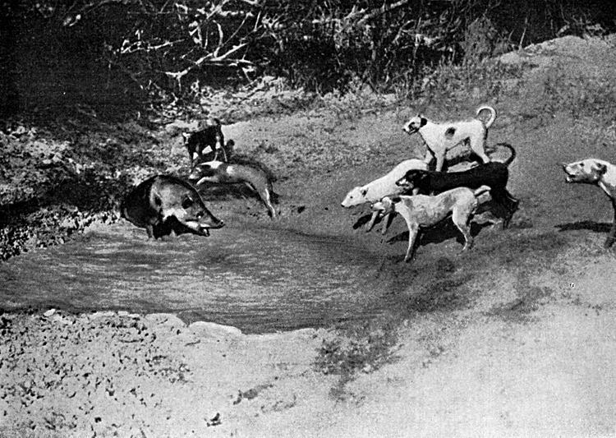
Lesson 4 - Psalms
Trusting God in Our Prayers (22:12-21)
His detractors pursued him relentlessly even as scavenger dogs took advantaged of the wounded or injured (22:16, 20). SG
Psa. 22:16 Dogs have surrounded me; a band of evil men has encircled me, they have pierced my hands and my feet.
Psa. 22:17 I can count all my bones; people stare and gloat over me.
Have you ever felt that you were at someone’s complete mercy?

Slide 8
Lesson 4 - Psalms
Trusting God in Our Prayers (22:12-21)
Even though the psalmist felt the physical and emotional effects of the attacks of his enemies and the apparent absence of God he continued to pray to God in faith (22:19-21) SG
Psa. 22:19 But you, O LORD, be not far off; O my Strength, come quickly to help me.
Psa. 22:20 Deliver my life from the sword, my precious life from the power of the dogs.
Have you ever continued to pray when things appeared to be hopeless?

Slide 9
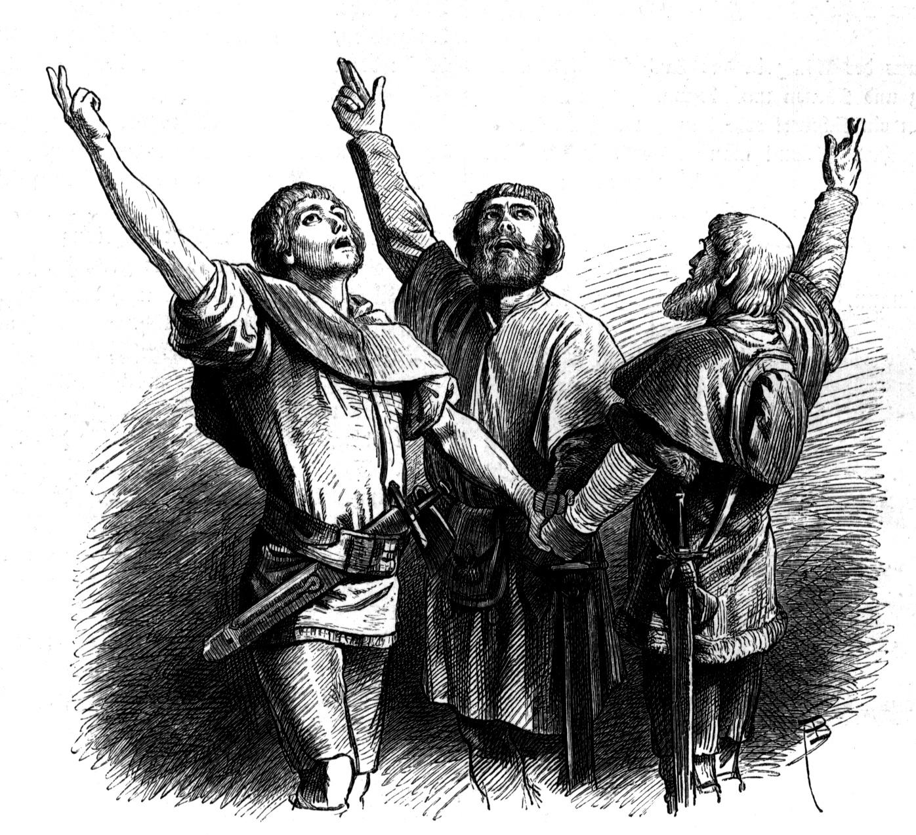
Lesson 4 - Psalms
Trusting God in Our Praise (22:22-31)
Something had happened. The misery and complaining of the previous verses has given way to praise. SG
Psa. 22:22 I will declare your name to my brothers; in the congregation I will praise you.
Psa. 22:23 You who fear the LORD, praise him! All you descendants of Jacob, honor him! Revere him, all you descendants of Israel!
Do you recall a time when your feeling of hopelessness turned to rejoicing?

Slide 10
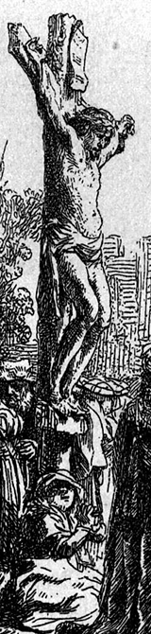
Lesson 4 - Psalms
The Gospel Writers Borrow from Psalm 22
In describing the suffering and death of Jesus…
Note his expression about being forsaken; Ps. 22:7;Matt. 27:46;Mark 15:34
The taunting about being delivered Ps. 22:8;Matt. 27:43
The Thirstiness of Jesus; Ps. 22:15; John 19:28
Casting lots for his clothes; Ps.22:18; Matt. 27:35; Mark 15:34; Luke 23:34; John 19:24 SG

Slide 11

Lesson 4 - Psalms
Questions to Ponder About This Study
When we experience suffering and sorrow, we too cry out to God with questions that begin with why. Our responsibility is to hold on to God, to cling to him. We do that through prayer. SG
In your opinion, what were the things that produced such misery within the psalmist?
2. Our writer suggests that verse 24 is the key verse in the best interpretation of this Psalm. Do you agree, or disagree? Why?

Slide 12
Lesson 4 - Psalms
Questions to Ponder About This Study
3. Which of the following two statements do you think is more accurate? Why do you think so?
God really did abandon Jesus while Jesus was on the cross.
The bearing of sin and the accompanying suffering made it seem to Jesus that God had abandoned him.
4. Recall a time in your life when your experience seemed to contradict what you believed about God. How did God deliver you?

Slide 13
Lesson 4 - Psalms
Questions to Ponder About This Study
5. Do you know a Jesus follower who suffered much but did so in full trust of God during that time? What did you learn from his or her experience?
End of Lesson 4
Lesson 5 is entitled “Committed to the Lord” – Psalm 31

Slide 14
Lesson 4 - Psalms

