Slide 1
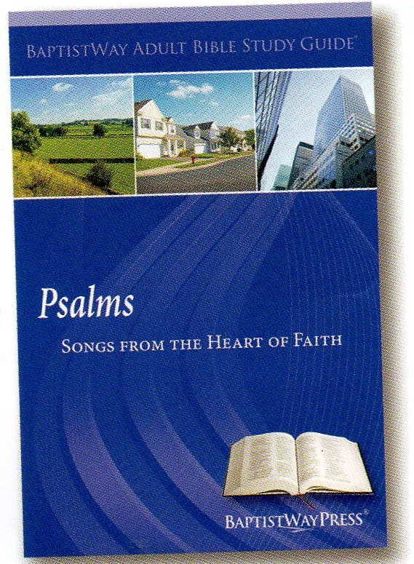
Lesson 3 Psalms
Lesson 3 of 13
March 17, 2013
“It’s a Wonderful Life”
Focal Text: Psalm 16
Quotations of Psalm 16 in the New Testament are found in
Acts 2:25-28, 31
Study Aim: To identify why I can rejoice in God.
All Scripture quotes are from the NIV version. Most lesson comments are from the Study Guide followed by SG
PowerPoint by Don Cannata
BaptistWay Press, Dallas, Texas

Slide 2
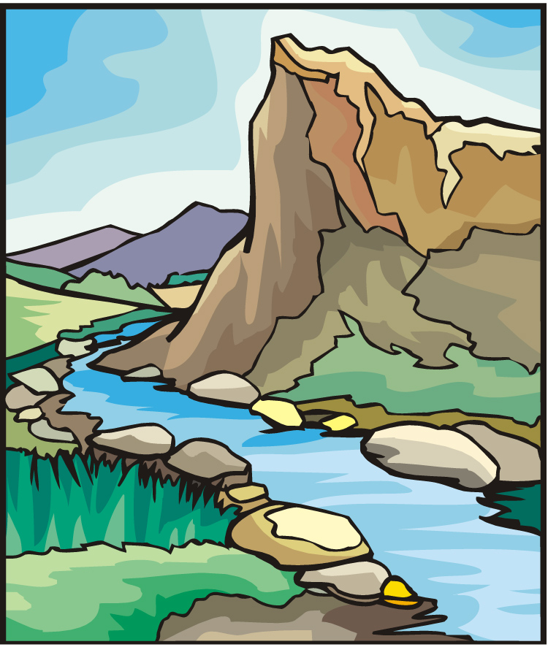
Lesson 3 Psalms
Overview of 13 Lesson Series in Psalms
1. Lord of All
2. God’s Majestic Greatness
3. It’s a Wonderful Life
4. Trusting God in the Darkest Hour
5. Committed to the Lord
6. The Joy of Forgiveness
7. Desiring Life and Finding Its Source
8. Gratitude for God’s Help
9. No One Does Good
10. A Desperate Cry
11. Testifying of God’s Security and Deliverance
12. Let us Worship, Let Us Obey
13. Give Thanks for the Lord’s Steadfast Love

Slide 3
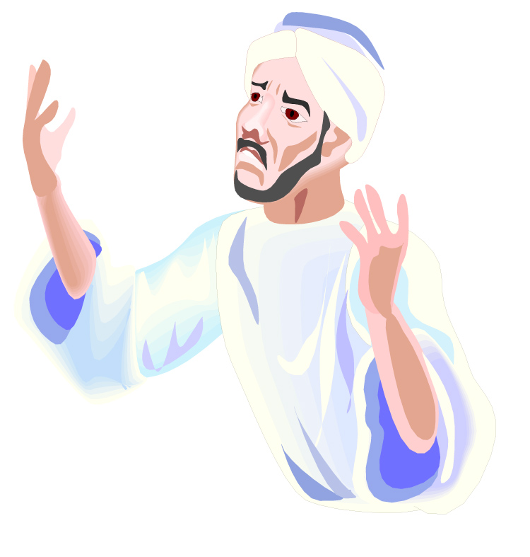
Lesson 3 Psalms
Understanding more about the Psalms
We speak of the Psalms as the Psalms of David. He has been considered the principle writer. He gives the keynote and his voice rises highest in the sacred choir.
But there were other authors besides him. Seventy-three of the 150 Psalms are assigned to him; fifty are anonymous. Psalm 90 was written by Moses.
Source: “What the Bible Is All About”, NIV Version, Gospel Light Publications, 1998,
p. 198 - 199

Slide 4
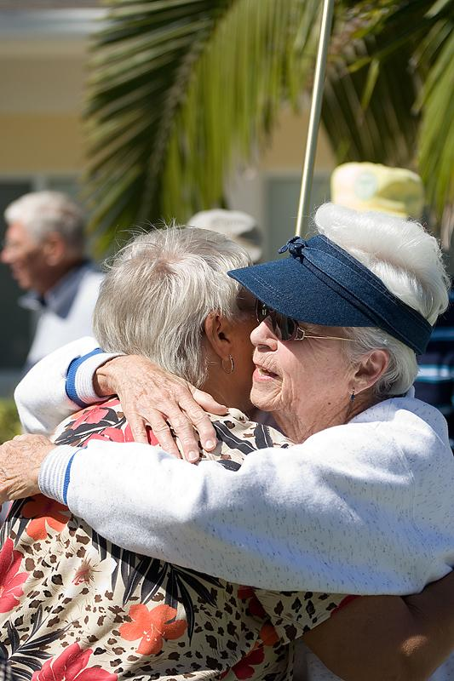
Lesson 3 Psalms
Introducing Psalm 16
There’s no about about it; life can indeed be hard. Psalm 16, though, provides lyrics of a different tone.
Instead of bemoaning life’s struggles and trials, David wrote a song to describe why it’s a wonderful life being a servant of the Lord. SG

Slide 5

Lesson 3 Psalms
Prayer for God’s Protection (16:1-2)
The psalm begins with a prayer.
A shepherd’s job was to keep watch over his flock.
David was now king or watchman of Israel.
God continually watches over us.
David recognized that God not only watched over him but that he belonged to God.
He gave God praise for giving him everything he had. SG

Slide 6
Lesson 3 Psalms
Prayer for God’s Protection (16:1-2)
Psa. 16:1 Keep me safe, O God, for in you I take refuge.
Psa. 16:2 I said to the LORD, “You are my Lord; apart from you I have no good thing.”
He offered this prayer in full confidence that the Lord was able to perform what David asked. SG
How does David’s praying compare to our praying?

Slide 7
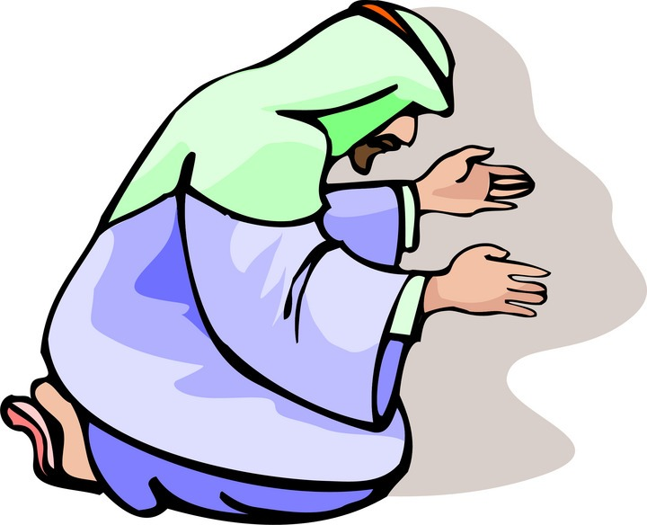
Lesson 3 Psalms
Distinction of God’s Divinity (16:3-4)
David contrasted the righteous followers of God with those who worshiped idols.
By using this distinction, the psalmist in verse 4 rejected two practices of pagan ritual, pouring out blood offering to the gods and using their names in utterances of magical incantation.
As worshipers of God and followers of Christ, we must be careful that our worship is pleasing to God. SG

Slide 8
Lesson 3 Psalms
Distinction of God’s Divinity (16:3-4)
Psa. 16:3 As for the saints who are in the land, they are the glorious ones in whom is all my delight.
Psa. 16:4 The sorrows of those will increase who run after other gods. I will not pour out their libations of blood or take up their names on my lips.
The psalmist’s loyalty to God can be seen in his refusing to take part in any portion of the idolater’s empty rituals. SG

Slide 9

Lesson 3 Psalms
Acknowledgement of God’s Provision and Guidance (16:5-8)
Psa. 16:5 LORD, you have assigned me my portion and my cup; you have made my lot secure.
Psa. 16:6 The boundary lines have fallen for me in pleasant places; surely I have a delightful inheritance.
Psa. 16:7 I will praise the LORD, who counsels me; even at night my heart instructs me.
Psa. 16:8 I have set the LORD always before me. Because he is at my right hand, I will not be shaken.

Slide 10

Lesson 3 Psalms
Declaration of God’s Deliverance (16:9-11)
In the final section of this psalm the psalmist made a declaration of faith in the Lord who can be trusted in every situation. David joyfully expressed the idea that God would not forsake him.
SG
Psa. 16:9 Therefore my heart is glad and my tongue rejoices; my body also will rest secure,
Psa. 16:10 because you will not abandon me to the grave, nor will you let your Holy One see decay.

Slide 11
Lesson 3 Psalms
Declaration of God’s Deliverance (16:9-11)
Psa. 16:11 You have made known to me the path of life; you will fill me with joy in your presence, with eternal pleasures at your right hand.
To dwell in the presence of God is the ultimate experience of life. David expressed the idea of having a covenantal relationship with God that allowed him to never be separated from God’s joyful presence. SG

Slide 12

Lesson 3 Psalms
Implications and Actions
God does not intend for us to worry needlessly about our days here on earth but rather to rejoice in knowing that God is in control.
Are you a Christian living in defeat? Start by memorizing the words of this psalm. SG
1. The psalmist cited the attributes of God that were most comforting to him. As you reflect on this Psalm, what attributes of God are most assuring to you?

Slide 13
Lesson 3 Psalms
2. What insights from this psalm can you incorporate into your life to enhance your worship of God?
3. What are some teachings of Jesus concerning life and death?
4. In what ways can this psalm change or deepen your prayer life?
Implications and Actions
End of Lesson 3
Lesson 4 is entitled “Trusting God in the Darkest Hour” – Psalm 22

Slide 14
Lesson 3 Psalms

