Slide 1

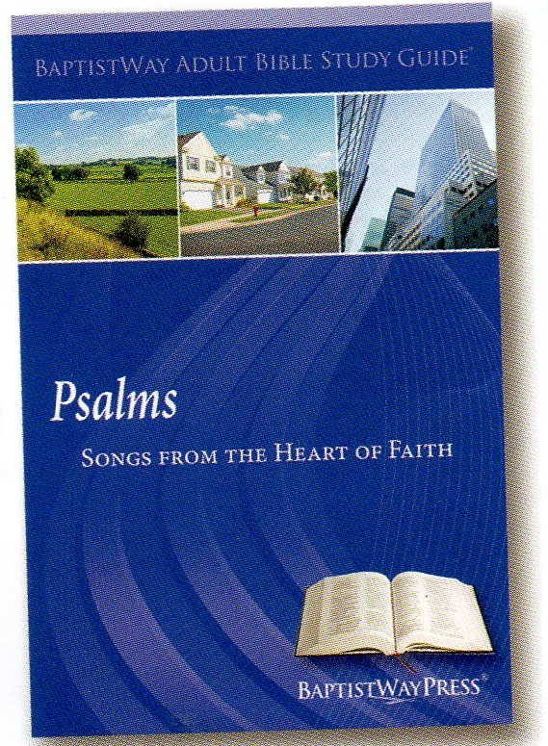
Lesson 2 of 13
March 10, 2013
“God’s Majestic Greatness”
Focal Text: Psalm 8
(Not all Focal Texts appear.)
References of Psalm 8 in the New Testament are found the at end of this lesson in Implications and Actions.
Study Aim: To identify how I have recognized God’s greatness
All Scripture quotes are from the NIV version unless otherwise indicated. Most lesson comments are from the Adult Study Guide followed by (SG).
PowerPoint by Don Cannata
BaptistWay Press, Dallas, Texas

Slide 2
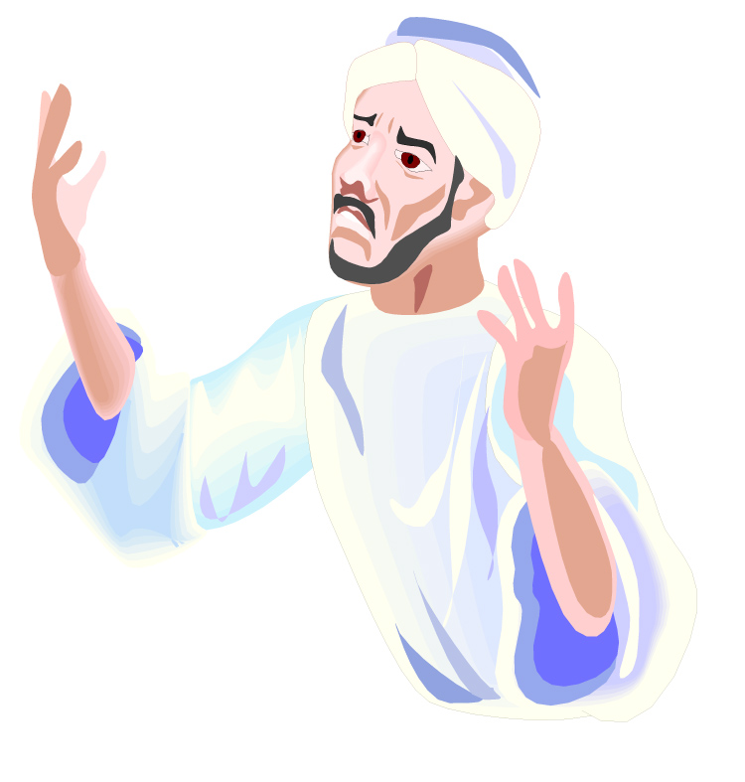
Lesson 2 Psalms
Understanding the Psalms
The Psalms is the national hymnbook of Israel. It contains 150 poems to be set to music for worship. Worship is the central idea. The Psalms magnify and praise the Lord, exalt His attributes, His names, His Word and His goodness. Every human experience is related to Him.
Source: “What the Bible Is All About”, NIV Version, Gospel Light Publications, 1998,
p. 198

Slide 3
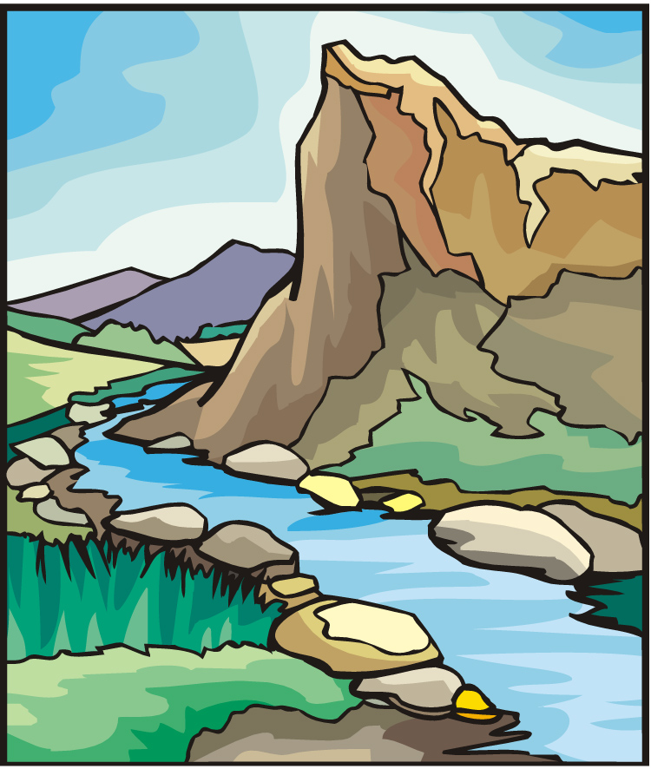
Lesson 2 Psalms
Overview of 13 Lesson Series in Psalms
1. Lord of All
2. God’s Majestic Greatness
3. It’s a Wonderful Life
4. Trusting God in the Darkest Hour
5. Committed to the Lord
6. The Joy of Forgiveness
7. Desiring Life and Finding Its Source
8. Gratitude for God’s Help
9. No One Does Good
10. A Desperate Cry
11. Testifying of God’s Security and Deliverance
12. Let us Worship, Let Us Obey
13. Give Thanks for the Lord’s Steadfast Love

Slide 4
Lesson 2 Psalms
Introducing Psalm 8
It is the first song of praise
Psalms 3-7 are lament or petition psalms in which someone is in trouble or suffering and is calling out to God for help.
Psalm 8 is also unique in that it is the only psalm that addresses God directly in the second person (you), rather than acting as a reminder to praise God or as a descriptor of reasons to praise. SG

Slide 5
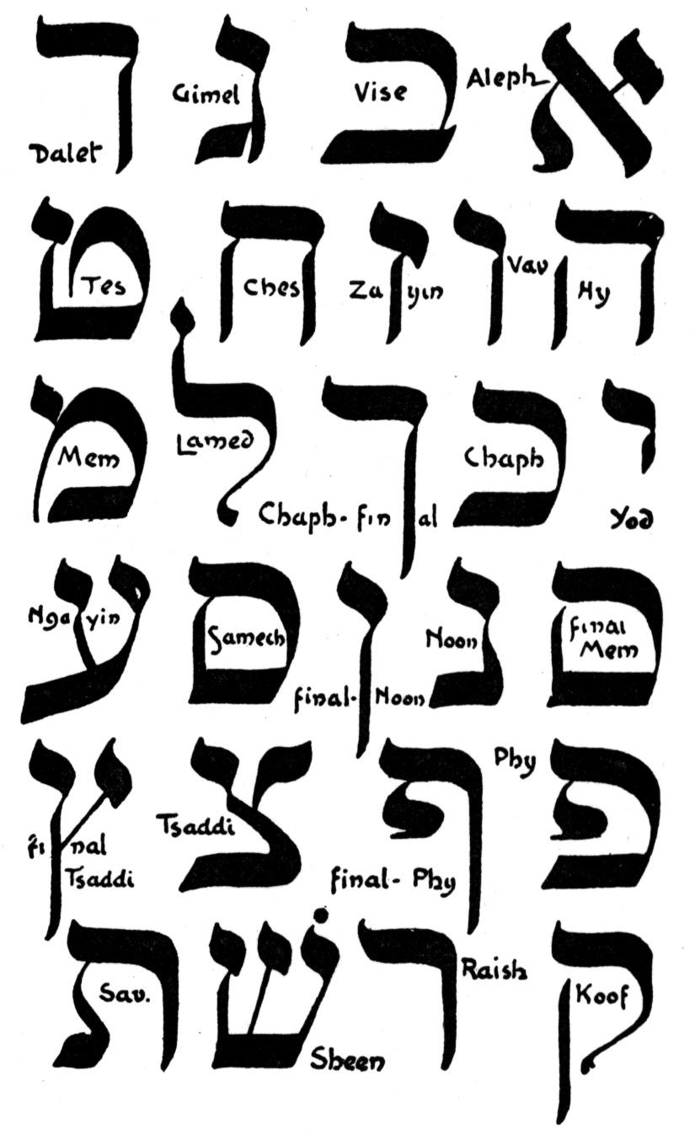
Lesson 2 Psalms
No Greater Majesty (8:1-2)
Begins with a refrain that is repeated at the end of the psalm
When the word Lord appears in small caps, it stands for the specific divine name of the God of Israel
God’s majesty is far greater then any earthly king
God’s majestic power is even so great that he able to use the speech of vulnerable, powerless babies to defeat any enemies SG

Slide 6

Lesson 2 Psalms
No Greater Majesty (8:1-2)
Psa. 8:1 O LORD, our Lord, how majestic is your name in all the earth! You have set your glory above the heavens.
Psa. 8:2 From the lips of children and infants you have ordained praise because of your enemies, to silence the foe and the avenger.

Slide 7
Lesson 2 Psalms
You Think About Me? (8:3-4)
The psalmist’s attention turned from God to humanity
The psalmist wondered how a God who is so powerful could actually think about or, even more, care for human beings
And although the psalmist wondered how and why, there was no doubt in the psalmist’s mind that the God who is greater than any power in existence does choose to think about and care for human beings. SG

Slide 8
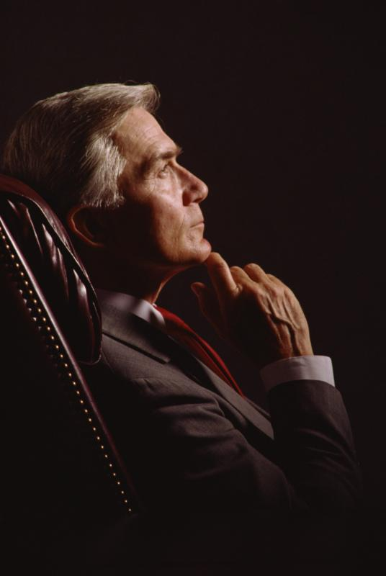
Lesson 2 Psalms
You Think About Me? (8:3-4)
Psa. 8:3 When I consider your heavens, the work of your fingers, the moon and the stars, which you have set in place,
Psa. 8:4 what is man that you are mindful of him, the son of man that you care for him?

Slide 9
Lesson 2 Psalms
A Special Place of Honor and Responsibility (8:5-9)
Knowing that the great Creator considers humble human beings, the psalmist then contemplated the special place
Humanity has the most elevated place among creation, for people are given power over every other created thing.
Looking up into the massive sky reminds us how truly majestic God is.
SG

Slide 10
Lesson 2 Psalms
A Special Place of Honor and Responsibility (8:5-9)
Psa. 8:5 You made him a little lower than the heavenly beings and crowned him with glory and honor.
Psa. 8:6 You made him ruler over the works of your hands; you put everything under his feet:
Psa. 8:7 all flocks and herds, and the beasts of the field,
Psa. 8:8 the birds of the air, and the fish of the sea, all that swim the paths of the seas.

Slide 11
Lesson 2 Psalms
A Special Place of Honor and Responsibility (8:5-9)
Psa. 8:9 O LORD, our Lord, how majestic is your name in all the earth!

Slide 12

Lesson 2 Psalms
Implications and Actions
Even though we have honor and authority, we are still lower than the One who has all the honor and authority. As such, we should live our lives as a reflection of God’s greatness. SG
1. Psalm 8 is quoted in the following New Testament passages: Matt.21:16;1 Cor. 15:27;Eph. 1:22;Heb. 2:6-8. How did the New Testament authors interpret them?

Slide 13
Lesson 2 Psalms
Implications and Actions
2. In what ways do children and infants bring praise to God as mentioned in Psalm 8:2?
3. How can we keep our perspective as human beings, who are “a little lower than the heavenly beings” (Psalm 8:5)?
4. In what ways can we take more seriously our role in having authority over creation?
End of Lesson 2 of 13
Lesson 3 is entitled “It’s a Wonderful Life”

Slide 14
Lesson 2 Psalms

