Slide 1

Lesson 13 of 13
February 24, 2013
“Women at the Cross and the Tomb: Serving Jesus to the End”
Focal Text: Mark 15:40-16:8
Study Aim: To state the significance of the presence of the women at Jesus’ crucifixion, his burial, and the empty tomb
All Scripture quotes are from the NIV version unless otherwise indicated. Most lesson comments are from the Study Guide followed by SG
PowerPoint by Don Cannata
BaptistWay Press, Dallas, Texas

Slide 2
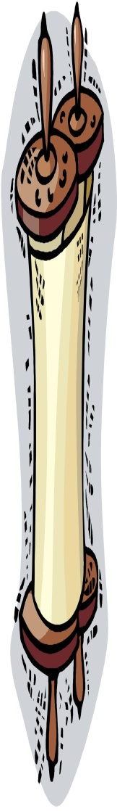
Lesson 13 - “The Gospel of Mark”
Overview of 13 Lesson Series
1. John the Baptist: Preparing for Jesus
2. Peter: Telling Jesus He’s Wrong
3. James and John: We Are First
4. Levi: Outsiders Welcome
5. A disturbed man: Freed from Being Out of Control
6. Two Desperate People: Relying on Jesus
7. Hometown People: Stuck in the Ordinary
8. The Religious Leaders: Bound By Tradition
9. The Disciples: Slow to Get It
10. The Law Expert: Asking About What Matters Most
11. The Woman at Bethany: Honoring Jesus Extravagantly
12. Judas: Doing the Unthinkable
13. Women at the Cross and the Tomb

Slide 3
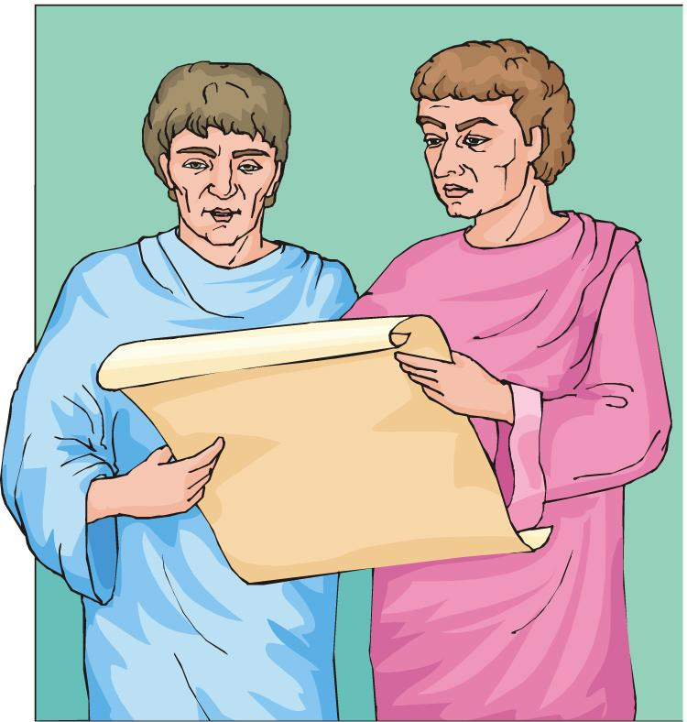
More About John Mark…
John Mark was the cousin of Barnabas (Col. 4:10) and the son of Mary, a leading woman in the Jerusalem church (Acts 12:12). He helped Paul and Barnabas on their first missionary journey, but not on the second.
Brief Gospel Outline
Introduction (1:1-13), Christ in Galilee (1:14-9:50), Journey to Jerusalem (Chap. 10), Jerusalem to crucifixion (Chaps. 11-15), Resurrection (Chap. 16)
Source: Warren Wiersbe, “With the Word”, Thomas Nelson, Nashville, 1991, p. 665

Slide 4
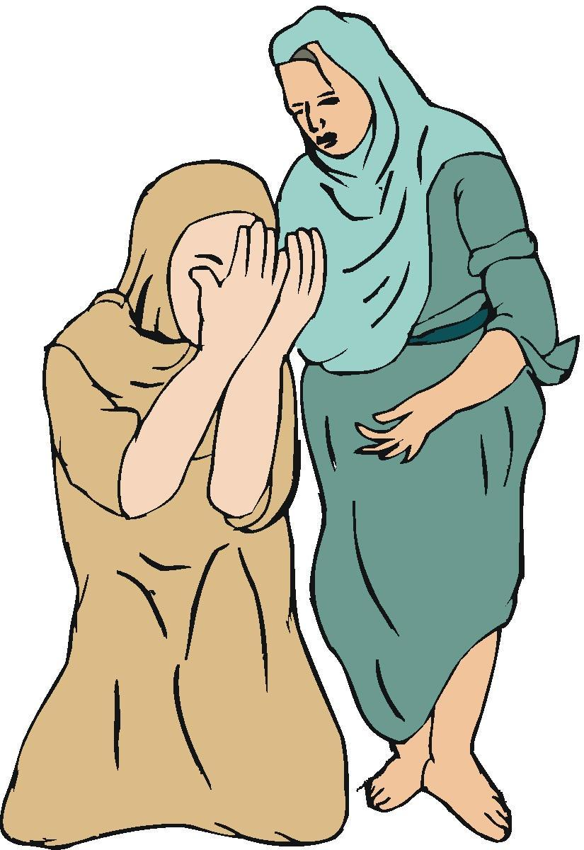
Lesson 13 - “The Gospel of Mark”
Focus of the Bible Lesson
“Women at the Cross and the Tomb: Serving Jesus to the End”
Focal Text: Mark 15:40-16:8
Women were faithfully present at Jesus’ crucifixion, his burial, and the empty tomb.
Women have and will continue to influence the course of history in profound ways. This reality was also true in the life and ministry of Jesus Christ. SG

Slide 5
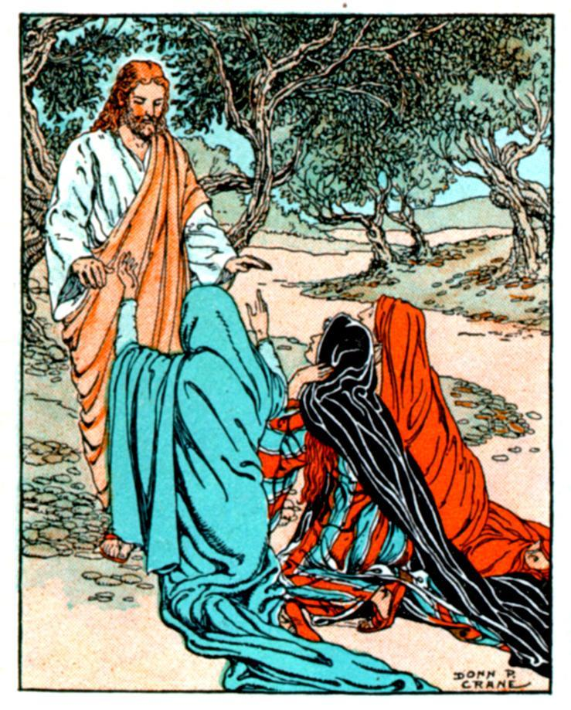
Lesson 13 - “The Gospel of Mark”
Looking On: Jesus Was Crucified (15:40-47)
Mark 15:40 Some women were watching from a distance. Among them were Mary Magdalene, Mary the mother of James the younger and of Joses, and Salome.
Mark 15:41 In Galilee these women had followed him and cared for his needs. Many other women who had come up with him to Jerusalem were also there.

Slide 6
Lesson 13 - “The Gospel of Mark”
Looking On: Jesus Was Crucified (15:40-47)
We do not find complete abandonment on the part of Jesus’ followers.
A group of women were looking on at these tragic events from a distance. Although these women do not receive much attention in the Gospels, we know that they played a crucial role in Jesus’ ministry. (15:41)
As heart-wrenching as it was, the women looked on and did not abandon their Lord. SG

Slide 7
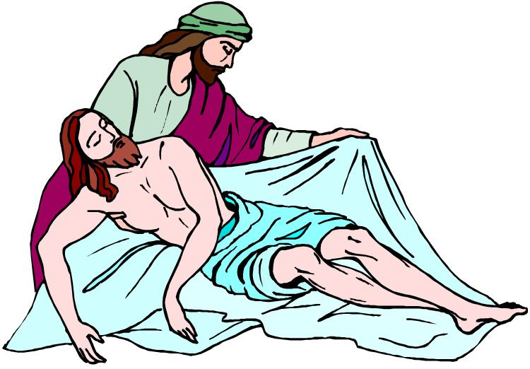
Lesson 13 - “The Gospel of Mark”
Looking On: Jesus Was Crucified (15:40-47)
After Jesus took his last breath, the ordeal was not over. Joseph of Arimathea played a key role in making sure that Jesus’ body was properly buried. He bought linen cloth and wrapped Jesus’ body in it. SG
Mark 15:46 So Joseph bought some linen cloth, took down the body, wrapped it in the linen, and placed it in a tomb cut out of rock. Then he rolled a stone against the entrance of the tomb.

Slide 8
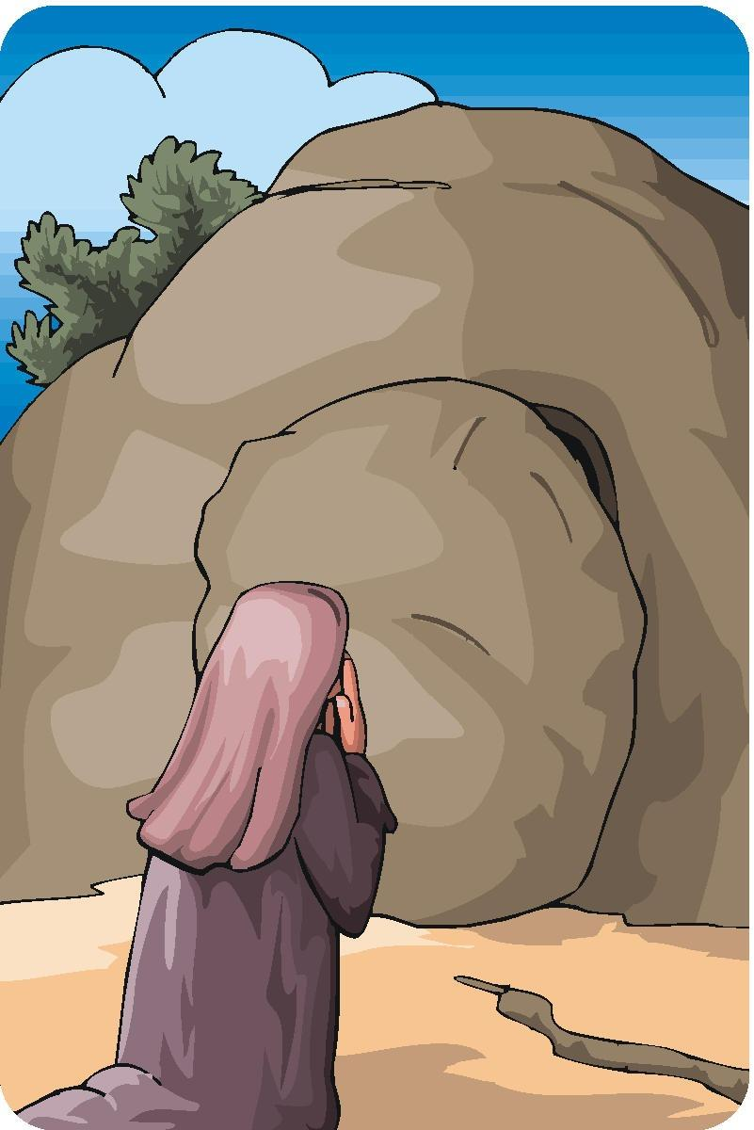
Lesson 13 - “The Gospel of Mark”
Looking On: Jesus Was Crucified (15:40-47)
As before, the disciples that we read so much about earlier in the Gospel were nowhere to be found.
Mary Magdalene, Mary the mother of James the younger and Joses, and Salome, however, remained until Joseph gave the very last push on the rock that rolled into place to cover the door of the tomb. SG
Mark 15:47 Mary Magdalene and Mary the mother of Joses saw where he was laid.

Slide 9
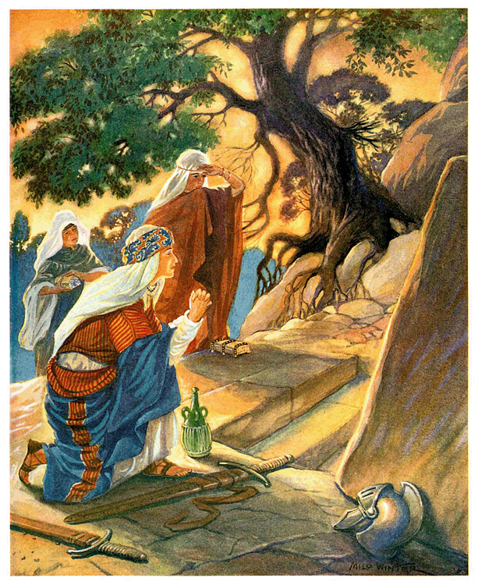
Lesson 13 - “The Gospel of Mark”
Looking Up: He Has Been Raised (16:1-8)
Mary Magdalene, Mary the mother of James, and Salome were still not finished. They returned to the tomb after the Sabbath was over in order to demonstrate their faithfulness in the final act of anointing Jesus’ body with spices. SG
Mark 16:1 When the Sabbath was over, Mary Magdalene, Mary the mother of James, and Salome bought spices so that they might go to anoint Jesus’ body.

Slide 10
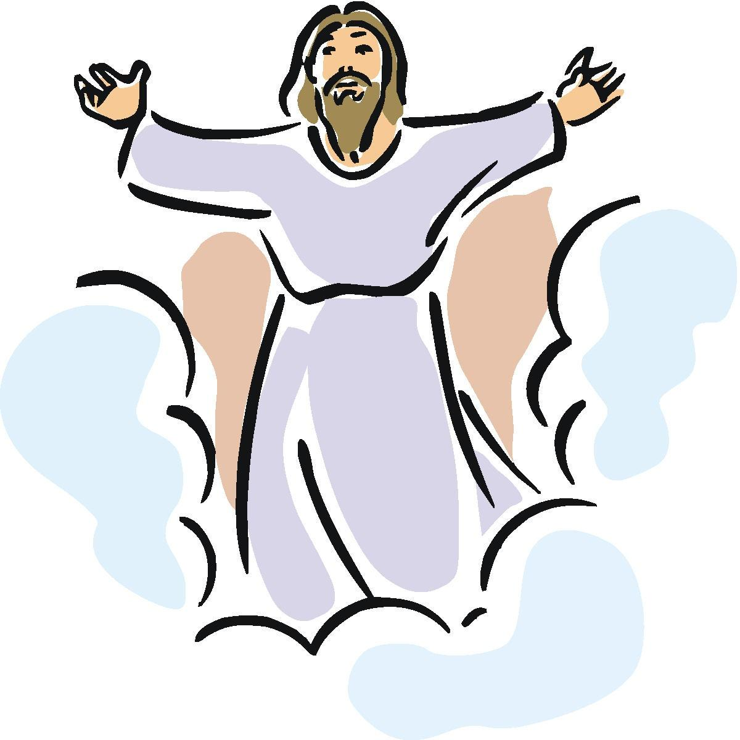
Lesson 13 - “The Gospel of Mark”
Looking Up: He Has Been Raised (16:1-8)
Mark 16:5 As they entered the tomb, they saw a young man dressed in a white robe sitting on the right side, and they were alarmed.
Mark 16:6 “Don’t be alarmed,” he said. “You are looking for Jesus the Nazarene, who was crucified. He has risen! He is not here. See the place where they laid him.
Mark 16:7 But go, tell his disciples and Peter, ‘He is going ahead of you into Galilee. There you will see him, just as he told you.’”

Slide 11
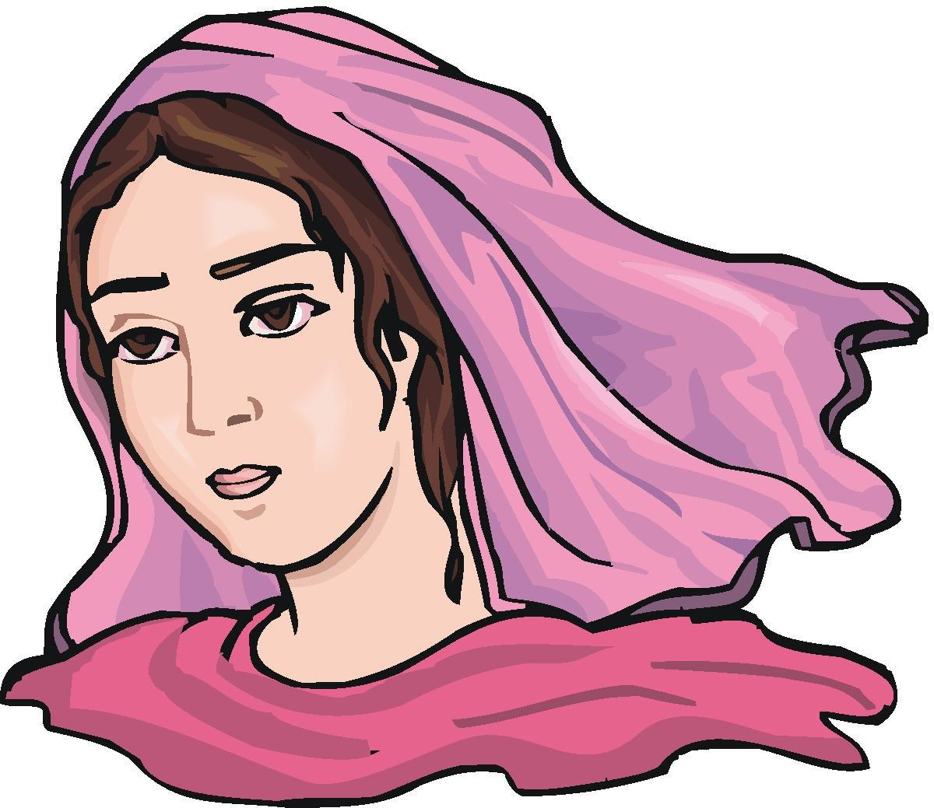
Lesson 13 - “The Gospel of Mark”
Looking Up: He Has Been Raised (16:1-8)
It is certainly worth noting the significance of women being the first of anyone in the world to go and tell about the resurrection of Jesus Christ. SG
Mark 16:8 Trembling and bewildered, the women went out and fled from the tomb. They said nothing to anyone, because they were afraid.

Slide 12

Lesson 13 - “The Gospel of Mark”
Implications and Actions
Does your faith reflect the unassuming and steady faithfulness of these women? The story of these women’s faithfulness serves to remind us that our faith in Christ is always rewarded with surprise, joy, and hope no matter how dark things seem to us. SG
1. How have the roles of women changed since the times of Jesus? Do you think women receive enough credit for the strength and faithfulness they demonstrate in difficult times?

Slide 13
Lesson 13 - “The Gospel of Mark
Implications and Actions
2. What do you think accounts for the steadfast faith of these women?
3. Mark 16:8 says that the women “fled from the tomb, for terror had seized them.” Why do you think the women were so afraid?
4. As you think back over the course of this study, with which character in Mark’s Gospel do you most identify? Review Slide #2.
End of Lesson 13 of 13

Slide 14
Lesson 13 - “The Gospel of Mark

