Slide 1

Lesson 11 of 13
February 10, 2013
“The Woman at Bethany: Honoring Jesus Extravagantly”
Focal Text: Mark 14:1-9
Study Aim: To measure how I serve Jesus by how the woman at Bethany served him
All Scripture quotes are from the NIV version unless otherwise indicated. Most lesson comments are from the Study Guide followed by (SG).
PowerPoint by Don Cannata
BaptistWay Press, Dallas, Texas

Slide 2

Overview of 13 Lesson Series
1. John the Baptist: Preparing for Jesus
2. Peter: Telling Jesus He’s Wrong
3. James and John: We Are First
4. Levi: Outsiders Welcome
5. A disturbed man: Freed from Being Out of Control
6. Two Desperate People: Relying on Jesus
7. Hometown People: Stuck in the Ordinary
8. The Religious Leaders: Bound By Tradition
9. The Disciples: Slow to Get It
10. The Law Expert: Asking About What Matters Most
11. The Woman at Bethany: Honoring Jesus Extravagantly
12. Judas: Doing the Unthinkable
13. Women at the Cross and the Tomb

Slide 3
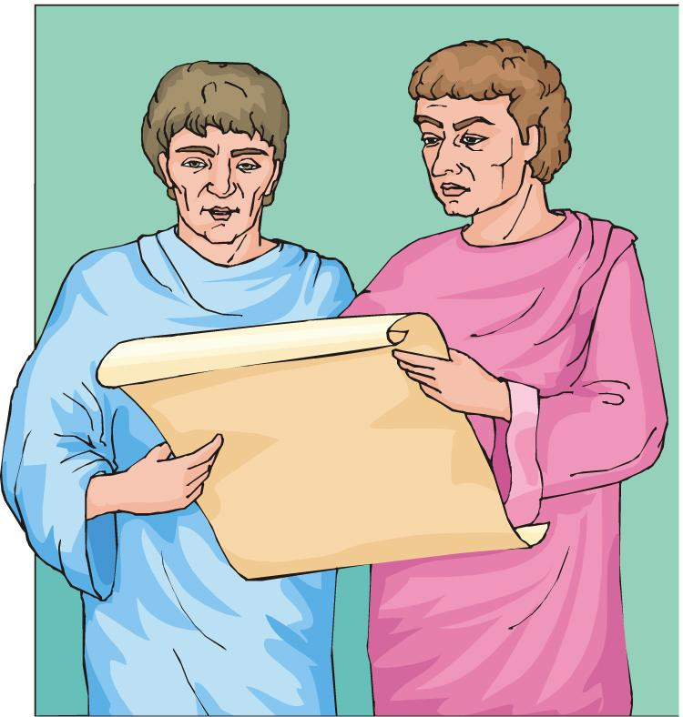
Lesson 11 – “The Gospel of Mark”
A Plan for Mark’s Gospel
During the year or more that Peter and Mark were so closely associated, they must have engaged in many earnest conversations about their Lord.
Outline of the Gospel
An introduction (1:1-20)
The Galilean Ministry (1:21-6:13)
Outside of Galilee (6:14-10:52)
Ministry in Jerusalem (11:1-14:22)
Crucifixion/Resurrection (14:43-16:20)
Source: Hugh R. Peterson, “A Study of The Gospel of Mark”, Convention Press, Nashville, TN 1958, p. 2

Slide 4
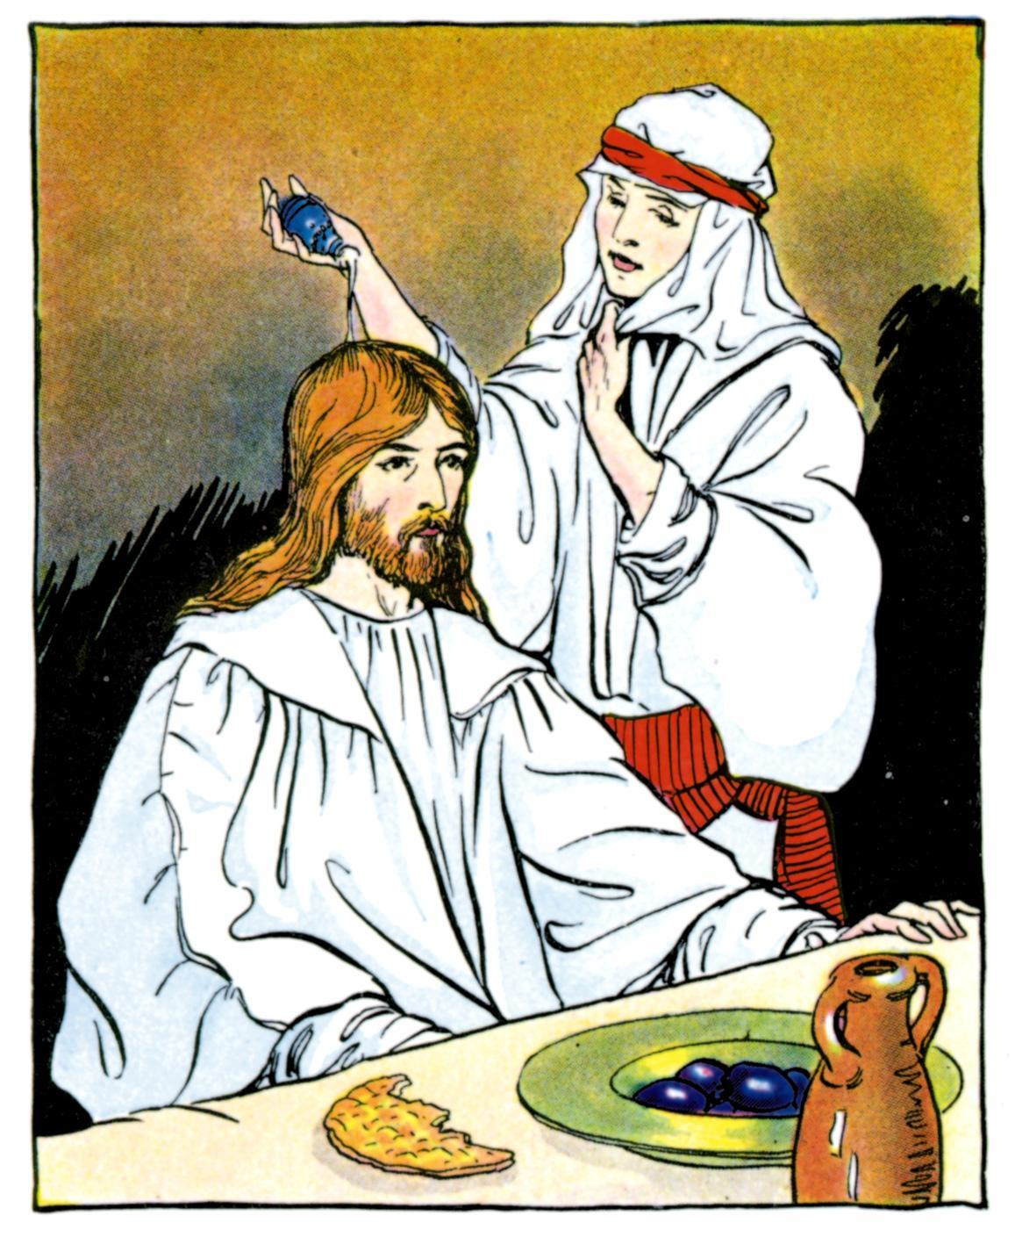
Lesson 11 – “The Gospel of Mark”
The Focus of This Lesson
Mark 14:1-9
This Scripture reveals the importance of an extravagant gift during the tension-filled week before the crucifixion. Jesus blessed the woman at Bethany who honored him with an extravagant gift.
Remembering this woman’s gift will help us to better measure our own giving and assist us in expressing our love for God. SG

Slide 5
Lesson 11 – “The Gospel of Mark”
Loving Without Reservation (14:1-3)
Mark 14:3 While he was in Bethany, reclining at the table in the home of a man known as Simon the Leper, a woman came with an alabaster jar of very expensive perfume, made of pure nard. She broke the jar and poured the perfume on his head.
Her love and gratitude for Jesus was unlimited, and her gift was without calculation of cost. Her example can lead us to open our hearts without reservation. SG

Slide 6
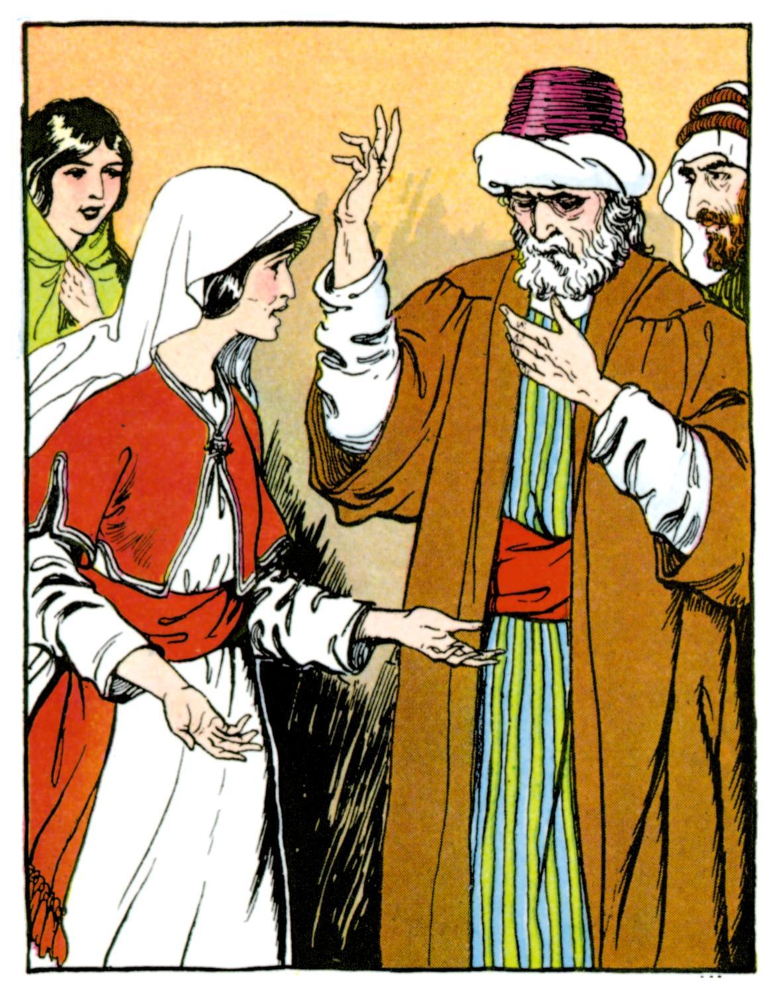
Lesson 11 – “The Gospel of Mark”
The Practicality of Impracticality (14:4-7)
Mark 14:4 Some of those present were saying indignantly to one another, “Why this waste of perfume?
Mark 14:5 It could have been sold for more than a year’s wages and the money given to the poor.” And they rebuked her harshly.
Giving to the poor was expected of the people of Israel
(Deut. 15:1-11). SG
Did they have a point?

Slide 7
Lesson 11 – “The Gospel of Mark”
The Practicality of Impracticality (14:4-7)
Mark 14:6 “Leave her alone,” said Jesus. “Why are you bothering her? She has done a beautiful thing to me.
Mark 14:7 The poor you will always have with you, and you can help them any time you want. But you will not always have me.
She could not have understood everything, but Jesus received her gift and deepened its meaning by saying this anointing was in preparation for his burial. SG

Slide 8
Lesson 11 – “The Gospel of Mark”
Doing What You Can (14:8-9)
Mark 14:8 She did what she could. She poured perfume on my body beforehand to prepare for my burial.
Mark 14:9 I tell you the truth, wherever the gospel is preached throughout the world, what she has done will also be told, in memory of her.”
None of us can do everything, but all of us can do something. God can change even small acts of kindness to those who suffer into life-changing gifts. SG

Slide 9

Lesson 11 – “The Gospel of Mark”
Questions to Ponder About the Lesson
Doing what you can may not seem extravagant to you, but in God’s hands it can be transformed into more than you can imagine. The extravagant gift of the woman at Bethany blessed Jesus and became an enduring memorial and encouragement. SG
1. How does the example of the woman at Bethany encourage you to give extravagantly? Or, does it?

Slide 10
Lesson 11 – “The Gospel of Mark”
Questions to Ponder About the Lesson
2. What are some ways Christians can be hospitable to those in need?
3. Since we will always have the poor with us, what should we do?
4. How does careful calculation sometimes get in the way of responding in love to others?
End of Lesson 11 of 13
Lesson 12 is entitled “Judas: Doing the Unthinkable” The focal text is Mark 14:10-11; 17-21, 41-50

Slide 11
Lesson 11 – “The Gospel of Mark”

