Slide 1

Lesson 9 of 13
January 27, 2013
“The Disciples: Slow to Get it”
Focal Text: Mark 6:45-52; 8:1-21
Study Aim: To trace the events in which the disciples were slow to understand Jesus’ identity and to analyze how I myself fail to understand who Jesus is.
All Scripture quotes are from the NIV version unless otherwise indicated. Most lesson comments are from the Study Guide followed by (SG).
PowerPoint by Don Cannata
BaptistWay Press, Dallas, Texas

Slide 2

Overview of 13 Lesson Series
1. John the Baptist: Preparing for Jesus
2. Peter: Telling Jesus He’s Wrong
3. James and John: We Are First
4. Levi: Outsiders Welcome
5. A disturbed man: Freed from Being Out of Control
6. Two Desperate People: Relying on Jesus
7. Hometown People: Stuck in the Ordinary
8. The Religious Leaders: Bound By Tradition
9. The Disciples: Slow to Get It
10. The Law Expert: Asking About What Matters Most
11. The Woman at Bethany: Honoring Jesus Extravagantly
12. Judas: Doing the Unthinkable
13. Women at the Cross and the Tomb

Slide 3
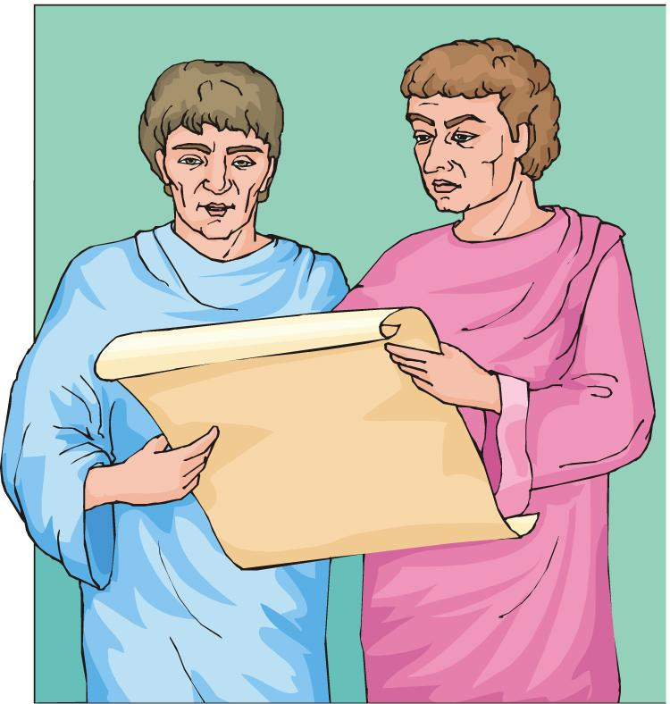
Lesson 9 - “The Book of Acts”
A Plan for Mark’s Gospel
During the year or more that Peter and Mark were so closely associated, they must have engaged in many earnest conversations about their Lord.
Outline of the Gospel
An introduction (1:1-20)
The Galilean Ministry (1:21-6:13)
Outside of Galilee (6:14-10:52)
Ministry in Jerusalem (11:1-14:22)
Crucifixion/Resurrection (14:43-16:20)
Source: Hugh R. Peterson, “A Study of The Gospel of Mark”, Convention Press, Nashville, TN 1958, p. 2

Slide 4
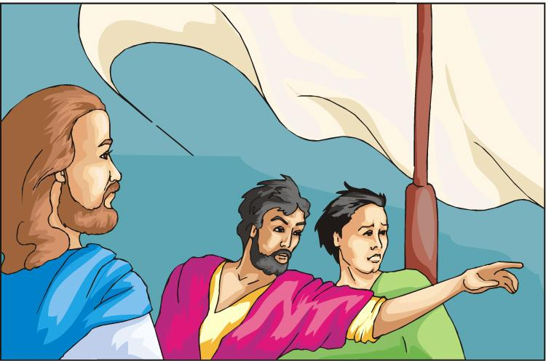
Lesson 9 “The Gospel of Mark”
Struggling to Grasp the Power of Jesus
In our view, Jesus’ power may be right in plain sight, but to the disciples it seemed elusive. With 2,000 years of history and an understanding of the cross and resurrection, our view is better. SG
Mark 6:45 Immediately Jesus made his disciples get into the boat and go on ahead of him to Bethsaida, while he dismissed the crowd.
Mark 6:46 After leaving them, he went up on a mountainside to pray.

Slide 5
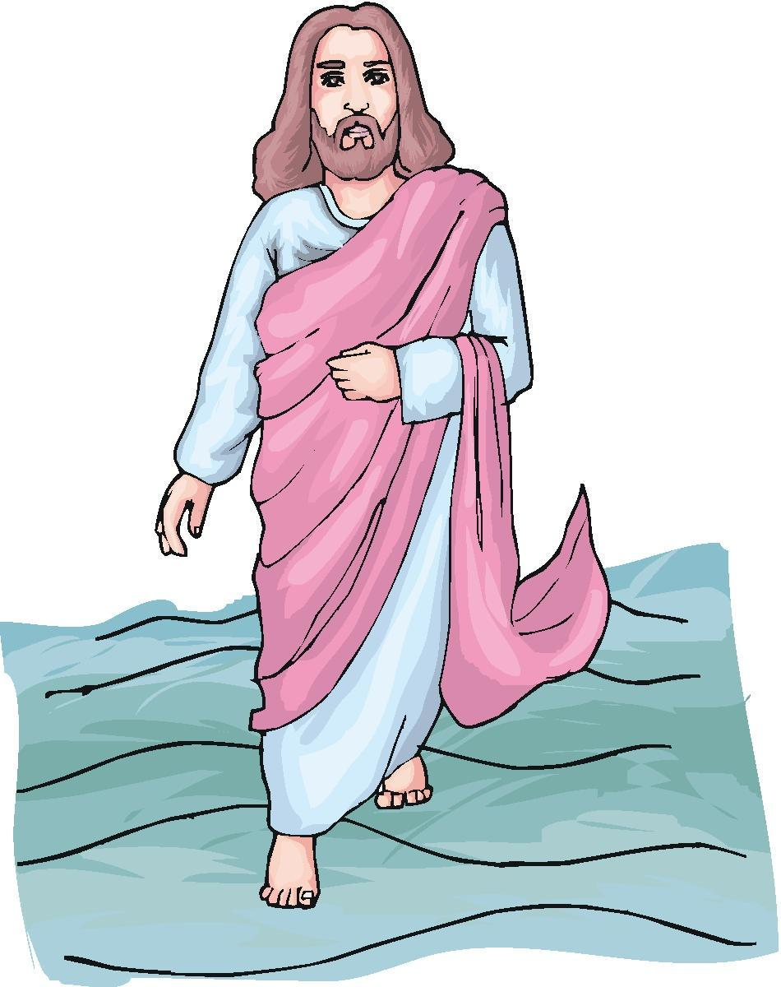
Lesson 9 “The Gospel of Mark”
Jesus Walking on the Water (6:45-52)
Mark 6:48 He saw the disciples straining at the oars, because the wind was against them. About the fourth watch of the night he went out to them, walking on the lake. He was about to pass by them,
Mark 6:49 but when they saw him walking on the lake, they thought he was a ghost. They cried out,
Mark 6:50 because they all saw him and were terrified. Immediately he spoke to them and said, “Take courage! It is I. Don’t be afraid.”

Slide 6
Lesson 9 “The Gospel of Mark”
Jesus Walking on the Water (6:45-52)
Mark 6:51 Then he climbed into the boat with them, and the wind died down. They were completely amazed,
Mark 6:52 for they had not understood about the loaves; their hearts were hardened.
They didn’t understand the miracle of the feeding of the 5,000 and, what’s more “their hearts were hardened.” They still did not understand who Jesus was or what he was about. SG
Would you have understood who Jesus was by this time?

Slide 7
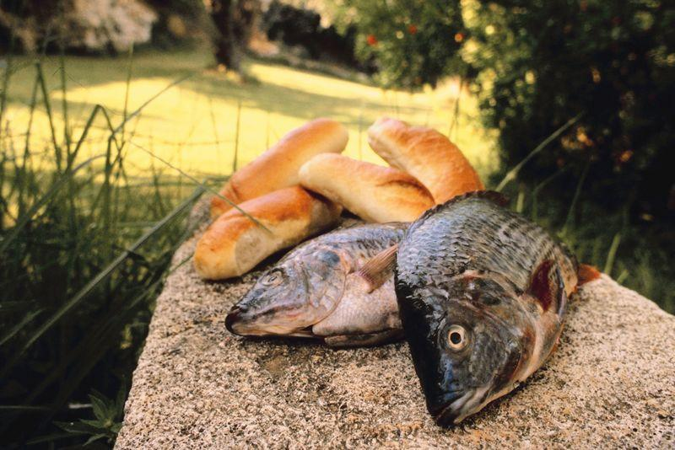
Lesson 9 “The Gospel of Mark”
4000 for Dinner – What to Serve? (8:1-10)
With regard to the audience, we should focus on the dense disciples. Once again Jesus took leadership and used miraculous power to feed the people. SG
Mark 8:1 During those days another large crowd gathered. Since they had nothing to eat, Jesus called his disciples to him and said,
Mark 8:2 “I have compassion for these people; they have already been with me three days and have nothing to eat.

Slide 8
Lesson 9 “The Gospel of Mark”
4000 for Dinner – What to Serve? (8:1-10)
Mark 8:8 The people ate and were satisfied. Afterward the disciples picked up seven basketfuls of broken pieces that were left over.
Mark 8:9 About four thousand men were present. And having sent them away,
Mark 8:10 he got into the boat with his disciples and went to the region of Dalmanutha.
Is there something we’ve been slow to see about what Jesus is doing in our lives? SG

Slide 9
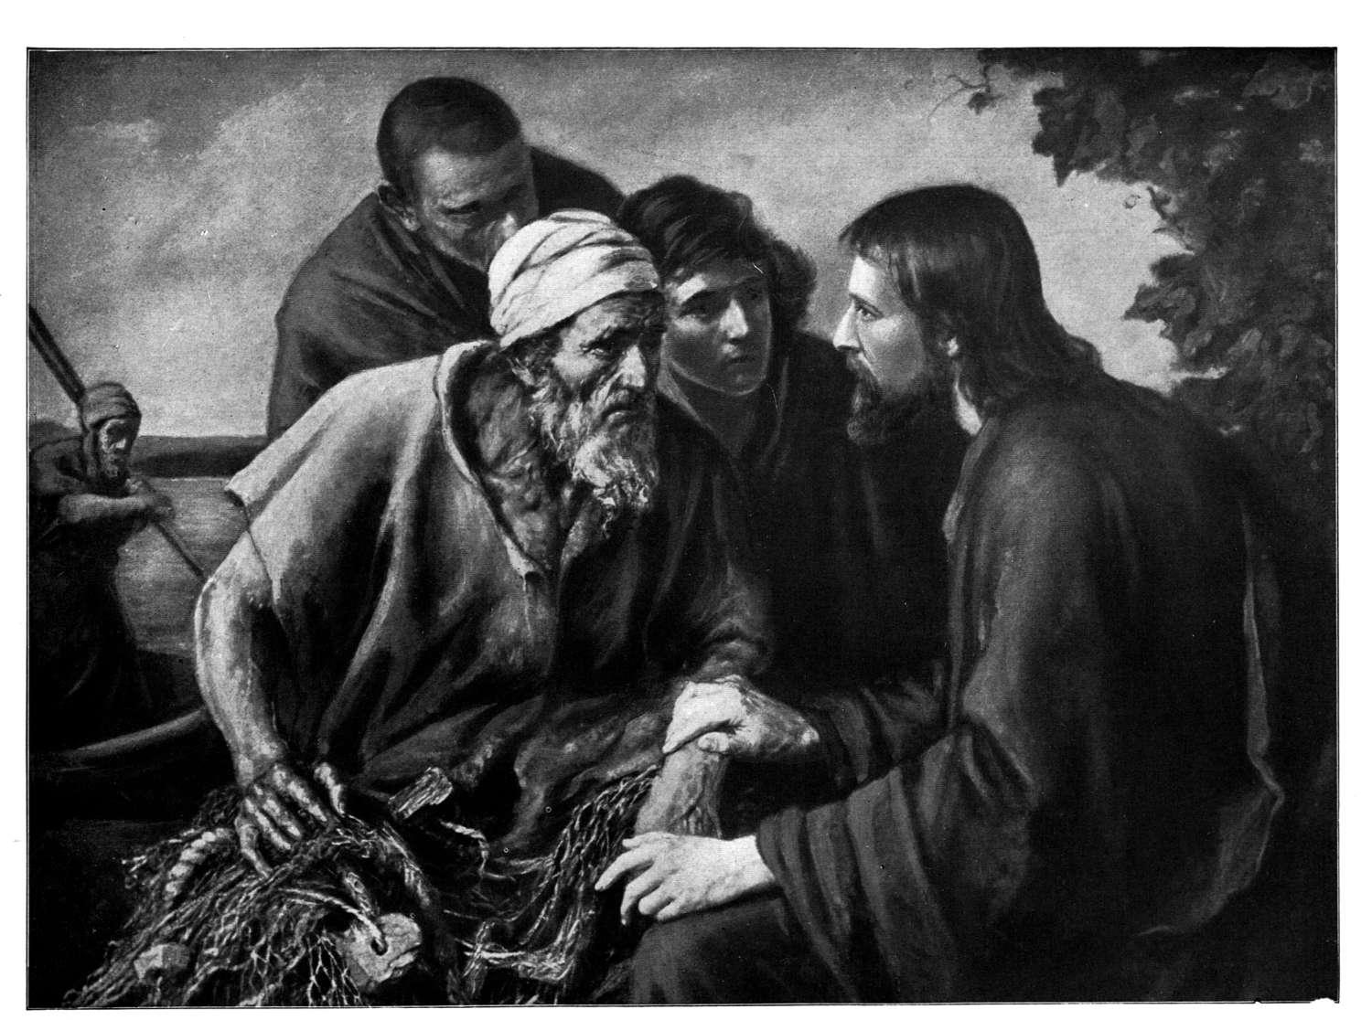
Lesson 9 “The Gospel of Mark”
Watch Out (8:14-21)
Jesus gave a warning about the leavening power of the Pharisees, building on the leaven as a metaphor for things that decay.
Mark 8:15 “Be careful,” Jesus warned them. “Watch out for the yeast of the Pharisees and that of Herod.”
Mark 8:16 They discussed this with one another and said, “It is because we have no bread.”
Mark 8:18 Do you have eyes but fail to see, and ears but fail to hear? And don’t you remember?

Slide 10
Lesson 9 “The Gospel of Mark”
Watch Out (8:14-21)
Mark 8:19 When I broke the five loaves for the five thousand, how many basketfuls of pieces did you pick up?” “Twelve,” they replied.
Mark 8:20 “And when I broke the seven loaves for the four thousand, how many basketfuls of pieces did you pick up?” They answered, “Seven.”
Mark 8:21 He said to them, “Do you still not understand?”
Sometimes we see God at work all around us but still miss ways God is breaking into our world. SG

Slide 11

Lesson 9 “The Gospel of Mark”
Implications and Actions
When Jesus walked on the water toward the disciples they thought he was a ghost. They were challenged in their faith. In what ways have you been scared when challenged in your faith?
How were the Pharisees and the disciples alike? How were they different?
3. Do we demand too much of God when we ask for “a sign from heaven”(8:11) ourselves?

Slide 12
Lesson 9 “The Gospel of Mark”
Implications and Actions
4. Jesus expected his disciples to do something for the hungry 4,000. In essence he said, You feed them. In what ways might Jesus be calling you to tap into spiritual power in order to meet someone else’s needs?
End of Lesson 9 of 13
Lesson 10 is entitled “The Law Expert: Asking About What Matters Most” -- Mark 12:28-34)

Slide 13
Lesson 9 “The Gospel of Mark”

